Slide 1



Older Adult
Suicide Prevention
Presenter Info
Notes:
Insert presenter contact information in text box prior to presentation.
Introduce yourself;
The ‘Know the Signs” Social Marketing Campaign for Suicide Prevention is part of statewide efforts to prevent suicide, reduce stigma and discrimination related to mental illness, and to promote the mental health and wellness of all people in California.
These initiatives are funded by counties through the Mental Health Services Act (Prop 63) and administered by the California Mental Health Services Authority (CalMHSA), an organization of county governments working to improve mental health outcomes for individuals, families, and communities.

Slide 2



Each Mind Matters
Each Mind Matters is California’s Mental Health Movement.
We are millions of individuals and thousands of organizations working to advance mental health.
2
Notes:
Know the Signs is part of Each Mind Matters: California's Mental Health Movement, which serves as the megaphone to amplify the voices of all people who want to put an end to stigma related to mental health and create a community where everyone feels comfortable reaching out for the support they deserve. Each Mind Matters is the umbrella in which all the resource information and campaign materials we’ll speak about falls under and assists you in targeting the different lifespans and diverse communities we’ll talk about in just a moment.

Slide 3

Suicide Prevention – Know the Signs
.
A statewide suicide prevention social marketing campaign with the overarching goal to increase Californians’ capacity to prevent suicide by encouraging individuals to know the signs, find the words to talk to someone they are concerned about, and to reach out to resources.
suicideispreventable.org elsuicidioesprevenible.org
.
3
Notes:
The Know the Signs campaign is designed to reach HELPERS, not the at-risk persons themselves. The campaign consists of ads (print, tv, radio, billboards, etc.), outreach materials, (posters, brochures, tent cards, etc.), toolkits, a film contest for high school students, and more. All materials drive audience members to the website suicideispreventable.org or for Spanish speakers to elsuicidioesprevenible.org

Slide 4
Why focus on Older Adults?
Most rapidly growing segment of our population
Have higher rates of suicide than other populations
Suicide behavior is more lethal later in life
Baby boomers and later cohorts have higher suicide rates than earlier cohorts
Notes:
For many years, most of the suicide prevention emphasis has been on youth and young adults. However, the data tells us that middle-aged and older adults die by suicide at higher rates and in larger numbers than youth. Prevention efforts may have been effective among youth; now we need to turn our attention to working-aged and older adults. As the population ages, suicide may continue to increase unless intervention and prevention programs are implemented.
Different agencies use varying definitions for this population. Some regard it as 65+ (the traditional retirement age and older); the California Area Agencies on Aging use 60+.

Slide 5
Reasons for Lethality of Attempts
Older adults are:
More frail (more likely to die)
More isolated (less likely to be rescued)
More plan oriented and determined
More likely to use firearms (restricting access to means is key)
Notes:
Regarding the higher lethality of attempts:
As we age, our bodies become more frail and thus an attempt is more likely to result in death
Aside from the increase in other risk factors associated with this (belongingness, lack of access to resources) isolation also decreases the chances that someone will be found after a suicide attempt in time for lifesaving actions to be taken.
There also seems to be greater sense of planning and determination in older adult attempters. Older adults also may have access to lethal means, including firearms and medications. And they tend to plan their deaths in advance, rather than act impulsively.
As you will see on the next slide, older adults are more likely than the average population to attempt suicide using a firearm.

Slide 6
CA Data on Older Adult Suicide
In 2013, there were 1,152 older adults (60+) who died by suicide in California. This represents 29% of the overall suicides in CA during 2013 (3,990).
The suicide rate of older adults in California is 16.9 (higher than the rate of 10.4 for all age groups combined)
CA Dept. of Public Health, “Epicenter” CA Injury Data Online:
http://epicenter.cdph.ca.gov/
Notes:
Older adults make up 29% of all suicides in CA, according to 2013 data, however they only represent 18% of the population.
Note: Population listed for all ages on “Epicenter” is 38,202,206, older adult population is listed as 6,820,715 (6,820,715/38,202,206=0.1785)
2013 is the most recent year for which statewide data is available. You may have more recent data in your own county.

Slide 7
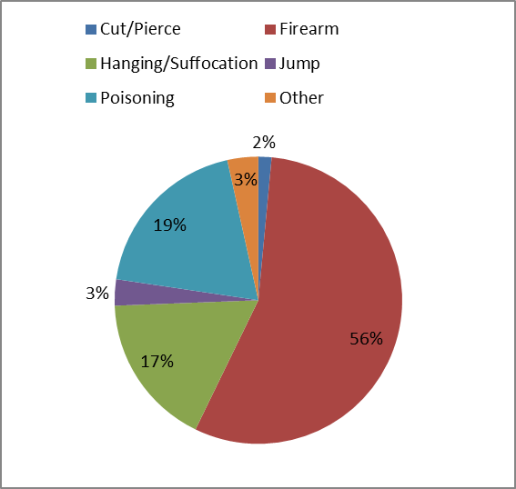
Means - Older Adult Suicides
Cut/Pierce | 17
Firearm | 642
Hanging/ Suffocation | 198
Jump | 34
Poisoning | 221
Other | 40
Total | 1,152
CA Dept. of Public Health
“Epicenter” CA Injury Data Online:
http://epicenter.cdph.ca.gov/
Notes:
As you can see, firearm deaths account for the largest percentage of deaths by suicide in the older adult population (56% vs. 39% among all groups). For many reasons, restricting access to lethal means continues to be one of the most important preventative strategies with all age groups especially older adults. Poisoning represents the second most commonly used means, which differs from other age groups. With higher medication use in older ages, efforts to engage primary care practices and pharmacists can be effective strategies.
Approximately 70%–80% of antidepressants are prescribed in the primary care setting.
[Mojtabai, R., & Olfson, M. (2008). National patterns in antidepressant treatment by psychiatrists and general medical providers: Results from the National Comorbidity Survey replication. Journal of Clinical Psychiatry, 69(7), 1064–74]

Slide 8
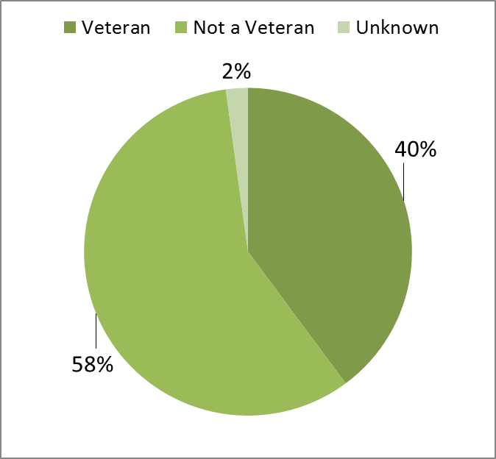
Veteran Status - Older Adult Suicides
Veteran | 459
Not a Veteran | 668
Unknown | 25
Total | 1,152
CA Dept. of Public Health
“Epicenter” CA Injury Data Online:
http://epicenter.cdph.ca.gov/
Notes:
Veteran status for suicide deaths is higher among older adults, however it is important to consider that veteran status in the overall population is higher in older age groups.
In addition to the chart shown, there were 693 veteran suicides in 2013 with 459 of them among older adults.

Slide 9
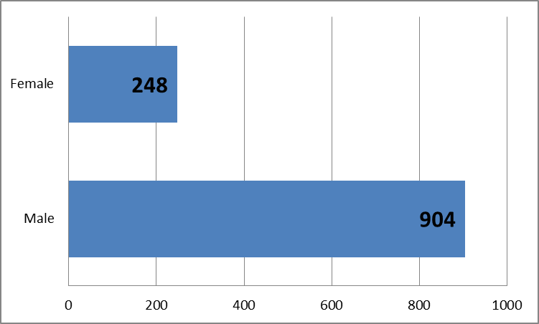
Suicides by Gender – Older Adults
CA Dept. of Public Health, “Epicenter” CA Injury Data Online:
http://epicenter.cdph.ca.gov/
Notes:
As with all other age groups, there is a 3:1 ratio of male to females for deaths by suicide.
It is important to note that the suicide rate among older adult men is one of the highest in the state at 29.3 per 100,000

Slide 10
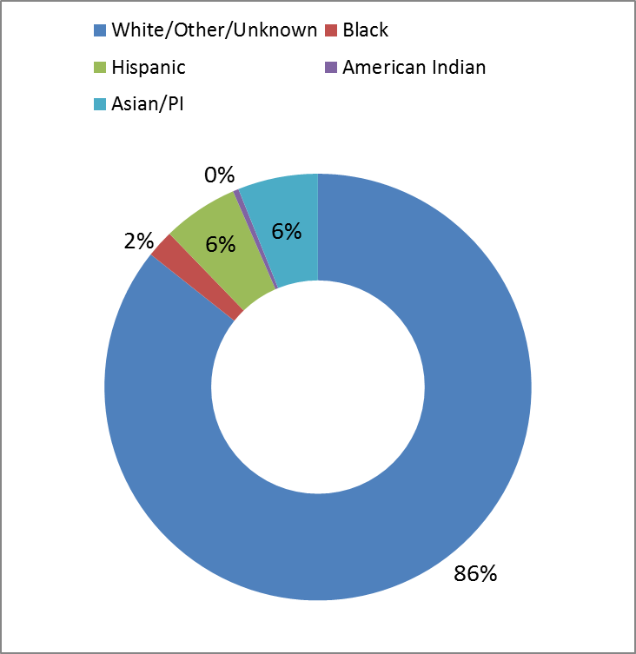
Suicides by Ethnicity – Older Adults
White/Other/ Unknown | 987
Black | 24
Hispanic | 66
American Indian | 5
Asian/PI | 70
Total | 1,152
CA Dept. of Public Health, “Epicenter” CA Injury Data Online:
http://epicenter.cdph.ca.gov/
Notes:
White middle aged and older males continue to be the group disproportionately affected by suicide. However, that doesn’t mean that being a white male by itself increases suicide risk. Likewise, not being a white older male doesn’t, by itself, reduce risk.
Regarding the data above, there are concerns about the reliability, particularly as it pertains to Native Americans.

Slide 11
Older Adult Warning Signs
The most critical warning signs of suicide are:
Talking about wanting to die or about suicide
Talking about feeling hopeless or having no reason to live
Looking for ways to kill oneself
Notes:
Now, let’s shift from the data to focusing on how to prevent suicide.
Most people who attempt suicide give some indication of their thoughts and feelings prior to taking action. These warning signs may be behaviors, words or attitude changes. Learning to recognize these signs and how to respond appropriately are actions that you can take that may help save a life. Warning signs are observable by others.

Slide 12
Older Adult Warning Signs (cont’d)
Additional warning signs of suicidality among older adults include:
Loss of interest in things or activities that are usually found enjoyable.
Cutting back on self-care and grooming.
Being alone for long periods of time, becoming socially isolated.
Breaking medical regimens (such as going off diets, prescriptions) or skipping doctor appointments.

Slide 13
Older Adult Warning Signs (cont’d)
Feeling hopeless and/ or worthless.
Putting affairs in order, giving things away, or making changes in wills – especially when combined with other warning signs.
Stock-piling medication or obtaining other lethal means such as a firearm.
A preoccupation with death or a lack of concern about personal safety. Remarks such as "This is the last time that you'll see me" or "I won't be needing any more appointments" should raise concern.
Notes:
Recent life changes such as the loss of a spouse or loved one may trigger more of these warning signs. Periods of heightened concern include those times as well as immediately after discharge from a nursing home or rehab center.

Slide 14
Older Adult Risk Factors
Depression
Prior attempts
Co-morbid general medical conditions
High pain and role function decline
Social dependency or isolation
Family discord, losses
Personality inflexibility, rigid coping
Access to lethal means
Notes:
Risk factors are characteristics that have been associated with increased risk among populations. They are not the same as warning signs.
Some risk factors increase with age, including social isolation as older people lose family members and friends to death and as their mobility becomes more limited; pain and health problems; fear of prolonged illness; and disabilities. Medical fragility means that a suicide attempt is more likely to be lethal or to have more drastic health consequences for the individual.

Slide 15
Depression in Older Adults
Depression in older adults often shows up in these ways:
Complaints of aches and pains
Fatigue
Slowed movements and speech
Loss of appetite
Inability to sleep or insomnia
Weight increase or decrease
Notes:
Additional symptoms of Depression in older adults include:
Blurred vision, dizziness, heart racing, anxiety.
Inability to concentrate, remember or think straight (sometimes mistaken for dementia).
An overall sadness or apathy, withdrawn; unable to find pleasure in anything.
Irritability, mood swings or constant complaining; nothing seems to make the person happy.
Talk of worthlessness, not being needed anymore, excessive and unwarranted guilt.
Frequent doctor visits without relief in symptoms; all tests come out negative.

Slide 16
Reasons for Suicide Attempts in Later Life
Social Problems:
  Belongingness:
    “I don’t belong anymore”
    “I don’t want to live on my own anymore”
    “I have no one to talk to”
Perceived burdensomeness:
  “I was in the way of my children”
  “I didn’t want to burden anyone anymore”
  “I wanted to escape the misery”
  NOTE: Social problems are bigger predictors than perceived burdensomeness
Notes:
http://www.ncbi.nlm.nih.gov/pubmed/25158916 (Van Orden, 2014)

Slide 17
Suicide Prevention in Older Adults
Suicide in late-life is not an expected or “normal” response to the stresses of aging
Resiliency:
  Positive emotions
  Emotion regulation
  Closeness in relationships
Notes:
Symptoms of depression can often be mistaken for “normal” signs of aging in an older population by providers and by patients themselves and their families. Depression also manifests differently in older adults, showing up not as dysphoria (sadness) but as loss of appetite, changes in sleep, and disinterest in activities once enjoyed. Other health issues such as incontinence may lead to increased social isolation.
However, it is important to note that older adults often have stronger protective factors in some cases, noted above under resiliency.

Slide 18
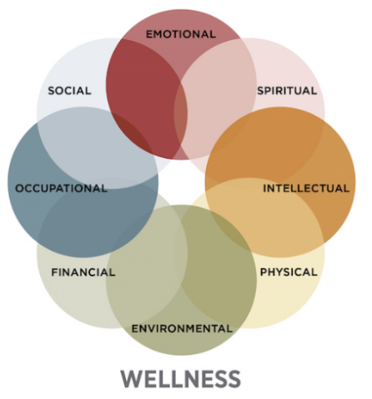
Eight Dimensions of Wellness
SAMHSA Wellness Initiative
http://www.samhsa.gov/wellness-initiative/eight-dimensions-wellness
Notes:
The comprehensive whole person wellness model that includes wellness dimensions has been shown to be effective with older adults.
The Eight Dimensions of Wellness are:
Emotional—Coping effectively with life and creating satisfying relationships
Environmental—Good health by occupying pleasant, stimulating environments that support well-being
Financial—Satisfaction with current and future financial situations
Intellectual—Recognizing creative abilities and finding ways to expand knowledge and skills
Occupational—Personal satisfaction and enrichment from one’s work
Physical—Recognizing the need for physical activity, healthy foods, and sleep
Social—Developing a sense of connection, belonging, and a well-developed support system
Spiritual—Expanding a sense of purpose and meaning in life
Based on the research article “Activities That Promote Wellness for Older Adults in Rural Communities” (http://www.joe.org/joe/2009october/rb2.php) the following results were found regarding what percentage of senior centers offered programs to address the various phases of the wellness model:
Activities for the social dimension were offered in 87% of the centers
Activities for the physical dimension were offered in 85% of the centers
Spiritual activities were offered in 61% of community centers
Occupational activities were offered in 37% of community centers,
While activities for the emotional dimension were offered in only 31% of centers.

Slide 19
Keys to Prevention
Aging services need to be coordinated with primary care and mental health care
Detection and effective treatment of depression
  Routine screening for depression
  Depression treatment is effective (and important to share this fact)
Interventions need to be aggressive
More universal prevention is key
Notes:
On average, 45% of people who died by suicide had contact with primary care providers within one month of their death, and over 75% had such contact within a year of their death. This is especially true of older adults who see their primary care providers more frequently than younger adults do. All of this suggests there may have been missed opportunities to identify the patient’s suicidality.
Luoma, J. B., Martin, C. E., & Pearson, J. L. (2002). Contact with mental health and primary care providers before suicide: A review of the evidence. American Journal of Psychiatry, 159(6), 909–16. Retrieved from http://www.ncbi.nlm.nih.gov/pubmed/12042175
The American College of Preventive Medicine recommends that all primary care practices have systems of care in place to assure accurate diagnosis, effective treatment, and follow-up for depression.

Slide 20
How to Start the Conversation
There are many ways to have a discussion with someone you are concerned about.
Ask directly about suicide if warning signs are present.
Here are some suggestions for starting the conversation.
Notes:
Dad, I’ve noticed some changes in you recently that are worrying me. You used to spend time at the barbershop with your buddies but you haven’t had a haircut in a long time. And you’re losing weight. Are you feeling all right? Is there something troubling you?
Other examples:
Joe, it’s not like you to avoid your friends. And I heard you say something earlier today about not being around to see who gets elected. I remember when Doug was suicidal a couple of years ago. Are you thinking about suicide?
Grandma, I’m worried about you. You just don’t seem yourself lately. I think your appetite is off and you haven’t been going to church lately. I’d like to make an appointment for you with your doctor and go with you to make sure that you aren’t experiencing depression. If you are, there are some good treatments that could help you feel much better.

Slide 21
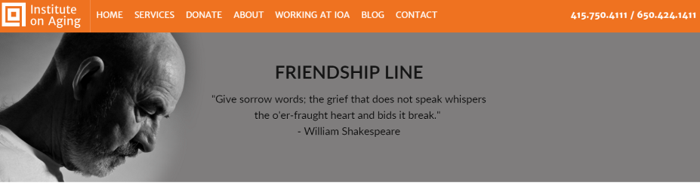
Resources
Friendship Line (Institute on Aging):
  (800) 971-0016
  www.ioaging.org
Notes:
We are fortunate to be the home of the Institute on Aging here in California, based out of San Francisco.
Institute on Aging’s 24-hour toll-free Friendship Line is the only accredited crisis line in the country for people aged 60 years and older, and adults living with disabilities. They also make on-going outreach calls to lonely older adults.

Slide 22
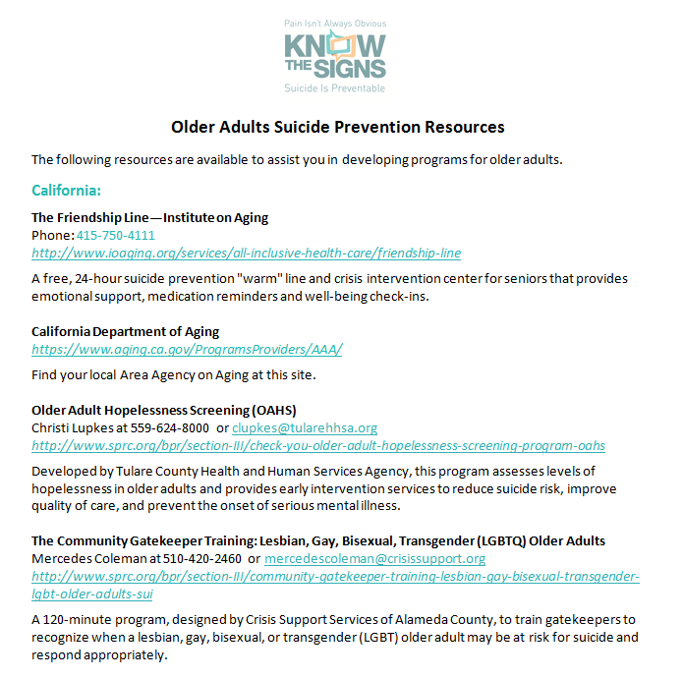
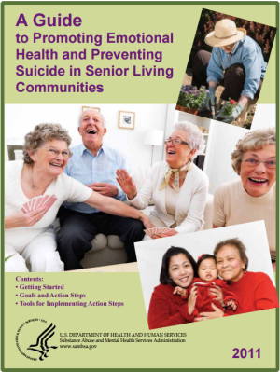

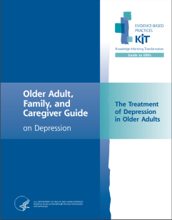
Resources
Notes:
Each Mind Matters created a listing of resources for older adult suicide prevention, which is included in the 2016 Suicide Prevention Week Toolkit.
The documents on screen are included in that listing; these were created by the US Dept. of Health and Human Services to assist caregivers and senior living center staff:
Older Adult, Family, and Caregiver Guide on Depression: The Treatment of Depression in Older Adults
A Guide to Promoting Emotional Health and Preventing Suicide in Senior Living Communities
Promoting Emotional Health and Preventing Suicide: A Toolkit for Senior Living Communities

Slide 23



Thank You
Presenter Info
23
Notes:
Time for taking questions and comments.

