Slide 1

Back to School
& Reopening
Social Media

Slide 2
Post 1

Slide 3
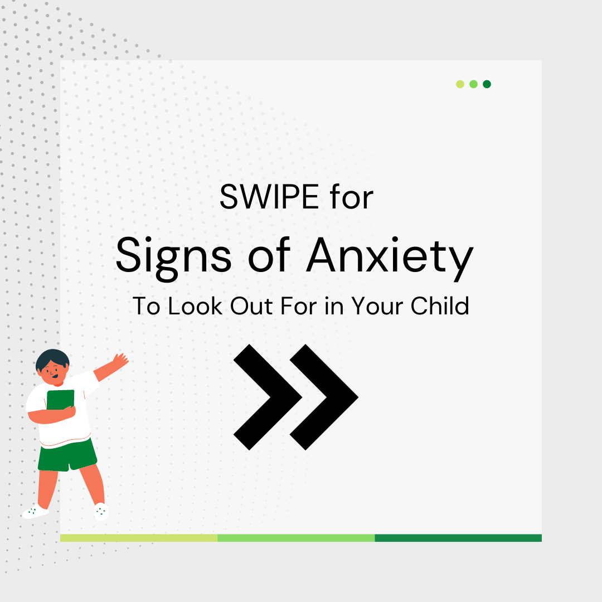
“The school year is just around the corner – and is going to be different than last year with the state reopening. Look out for these signs that your kid may be feeling anxious – you can swipe through the images to learn how different age groups display anxiety. If you notice any happening, take time to check in with them, talk to them about safety, and review a school safety plan you can work on together.”

Slide 4
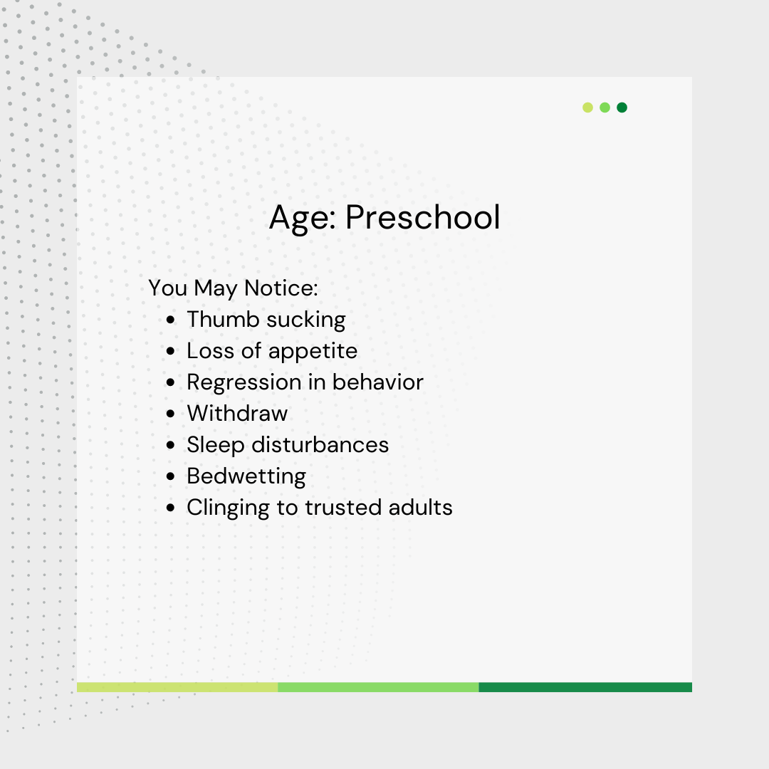
“The school year is just around the corner – and is going to be different than last year with the state reopening. Look out for these signs that your kid may be feeling anxious – you can swipe through the images to learn how different age groups display anxiety. If you notice any happening, take time to check in with them, talk to them about safety, and review a school safety plan you can work on together.”

Slide 5
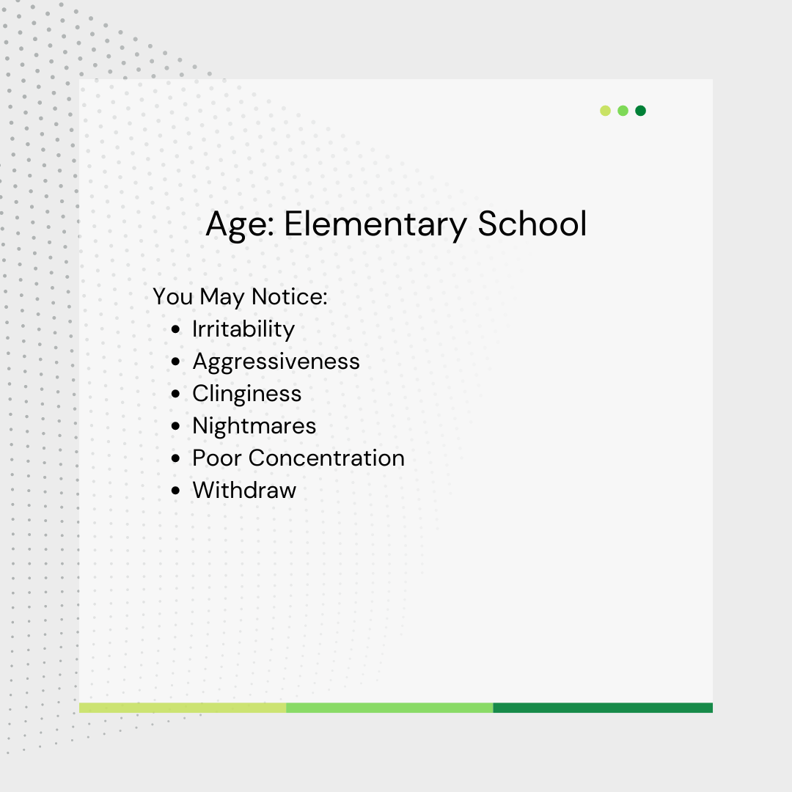
“The school year is just around the corner – and is going to be different than last year with the state reopening. Look out for these signs that your kid may be feeling anxious – you can swipe through the images to learn how different age groups display anxiety. If you notice any happening, take time to check in with them, talk to them about safety, and review a school safety plan you can work on together.”

Slide 6
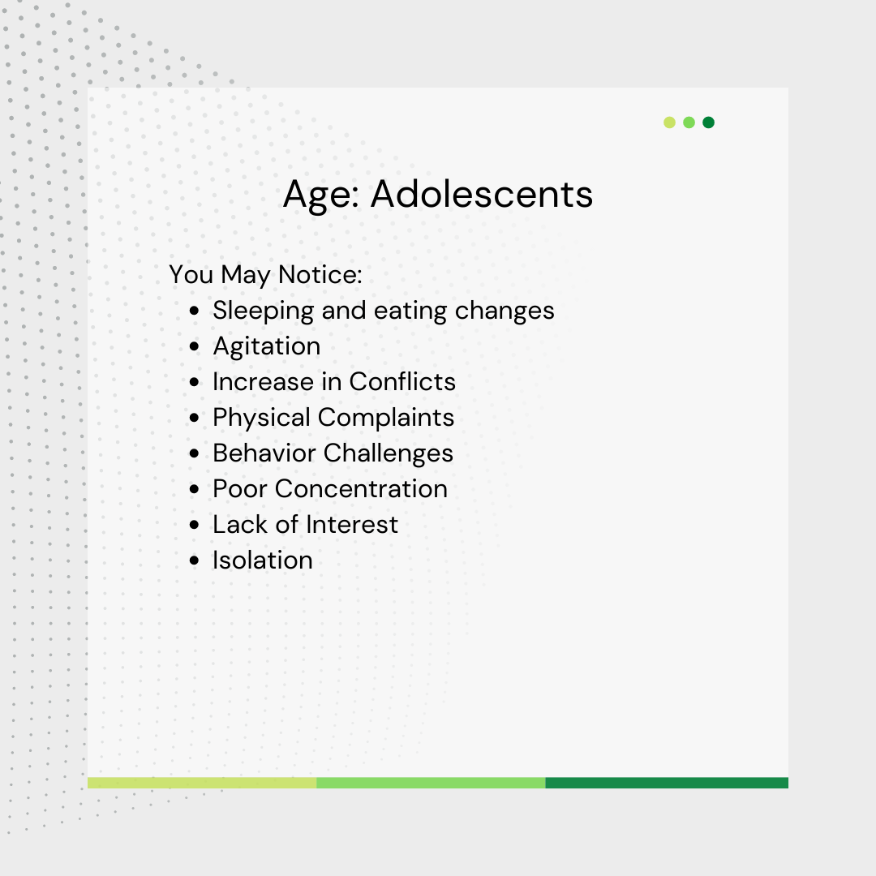
“The school year is just around the corner – and is going to be different than last year with the state reopening. Look out for these signs that your kid may be feeling anxious – you can swipe through the images to learn how different age groups display anxiety. If you notice any happening, take time to check in with them, talk to them about safety, and review a school safety plan you can work on together.”

Slide 7
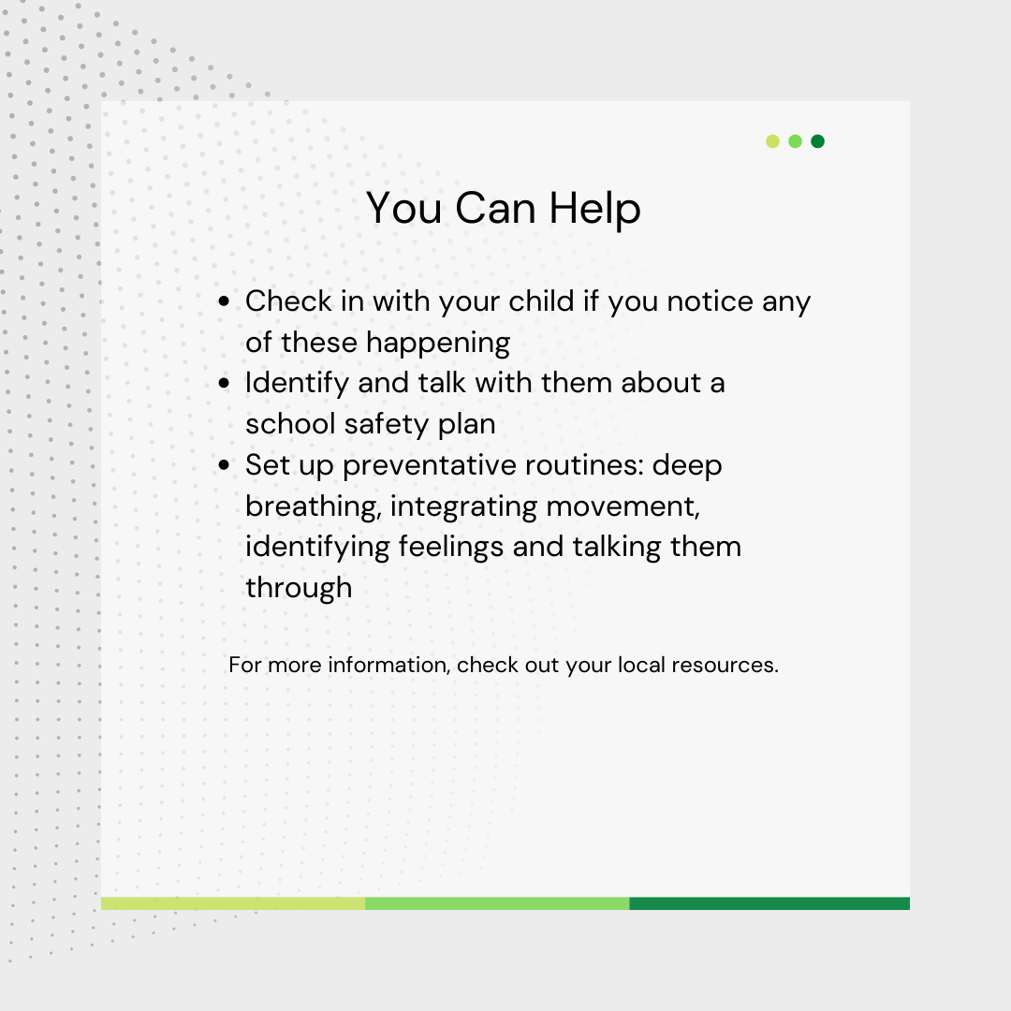
“The school year is just around the corner – and is going to be different than last year with the state reopening. Look out for these signs that your kid may be feeling anxious – you can swipe through the images to learn how different age groups display anxiety. If you notice any happening, take time to check in with them, talk to them about safety, and review a school safety plan you can work on together.”

Slide 8
Post 2 Option

Slide 9
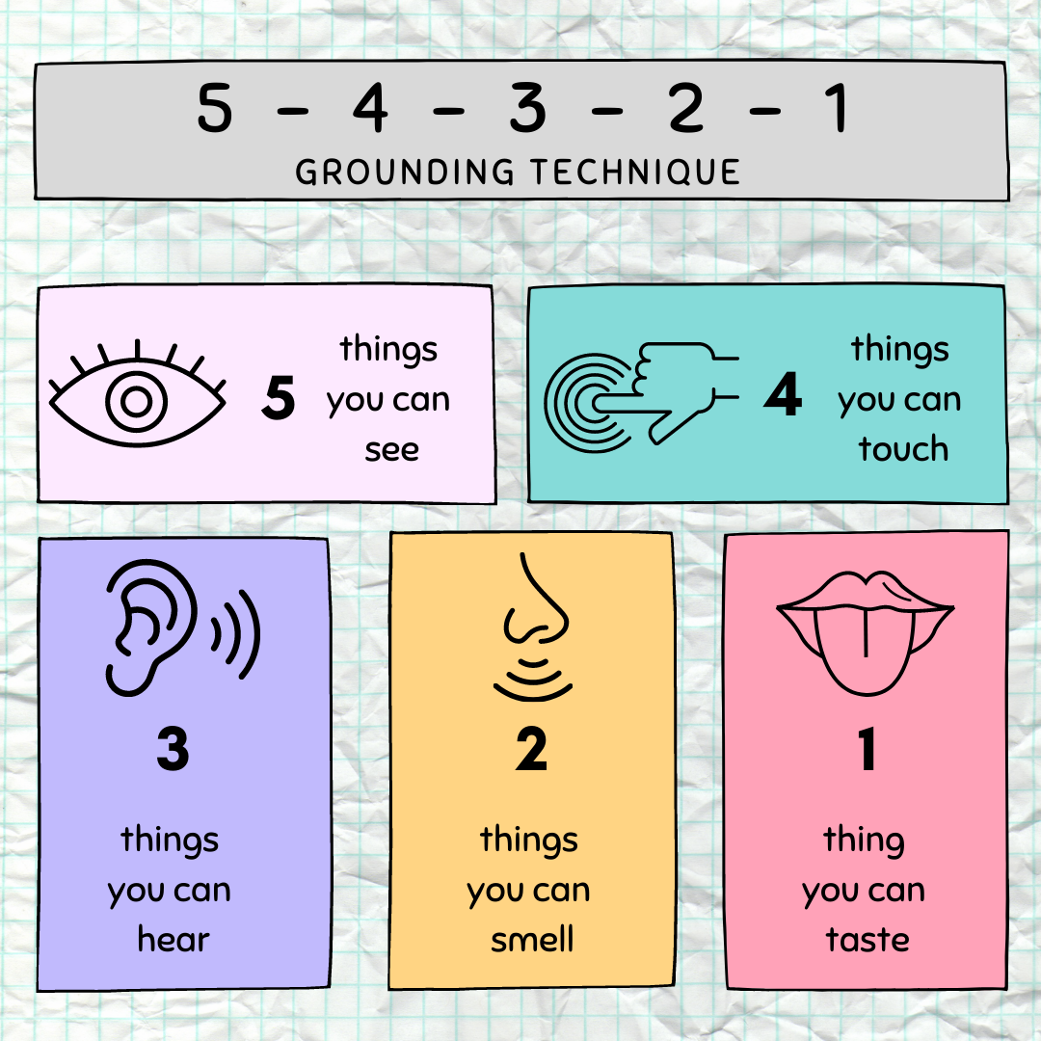
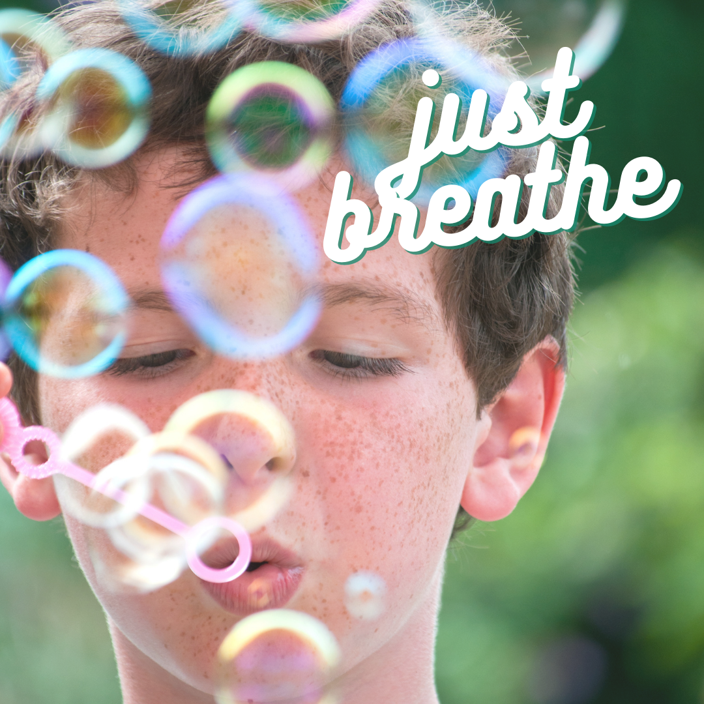
“How are you feeling about returning to school? Take some time to add some tools to your tool belt as you prepare for the school year. Here are some ideas:
Try the 5-4-3-2-1 Grounding Technique in the image above [only if useing image option 1]
Make deep breathing, meditation, body movement a part of your daily school routine
Identify and put a name to your emotions – how is it affecting you?
Establish safety school routines – everything from handwashing to changing clothes to snacks and homework”

Slide 10
Post 3 Option

Slide 11
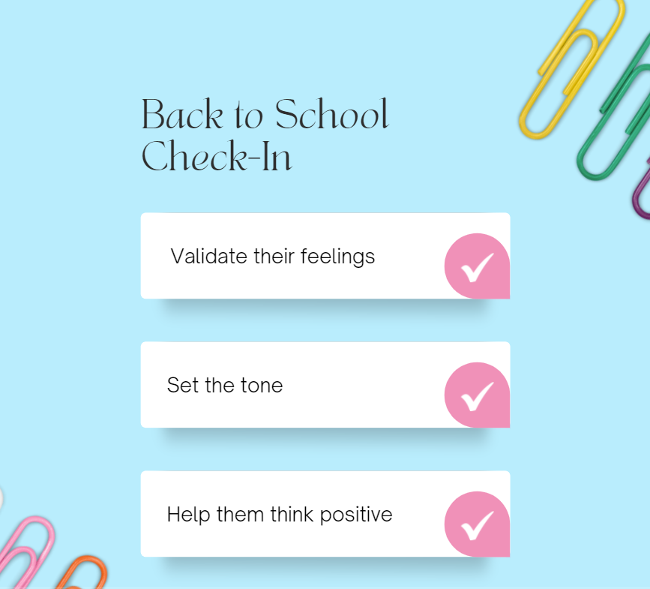
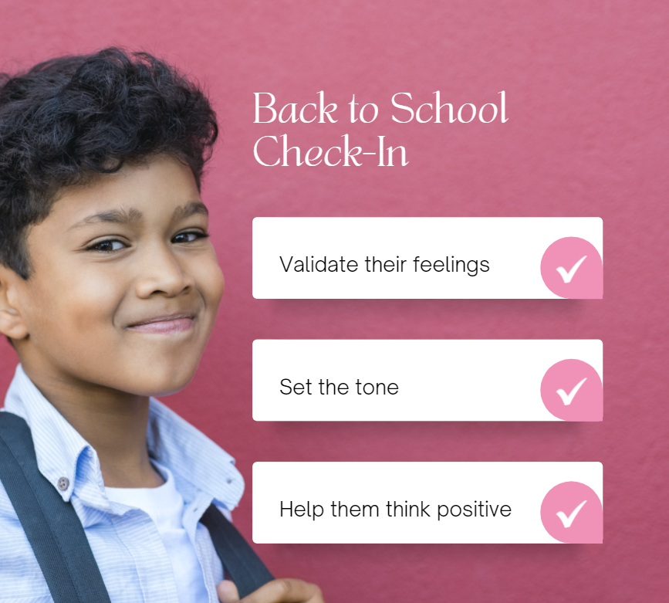
“Going back to school during COVID can bring up anxiety. Reassuring children that it’s safe, while also encouraging them to be careful can be challenging. How do you do that? Here are some pointers.
Give them space to express and validate their feelings.
Lead by example with positivity. Say what you know, working together to ask and answer questions can help them stay calm.
Try to get them to talk about the good things about school. What are they looking forward to?
There’s always more support when you need it, you can reach out to your local County [insert information here]…”

Slide 12
Post 4 Option

Slide 13
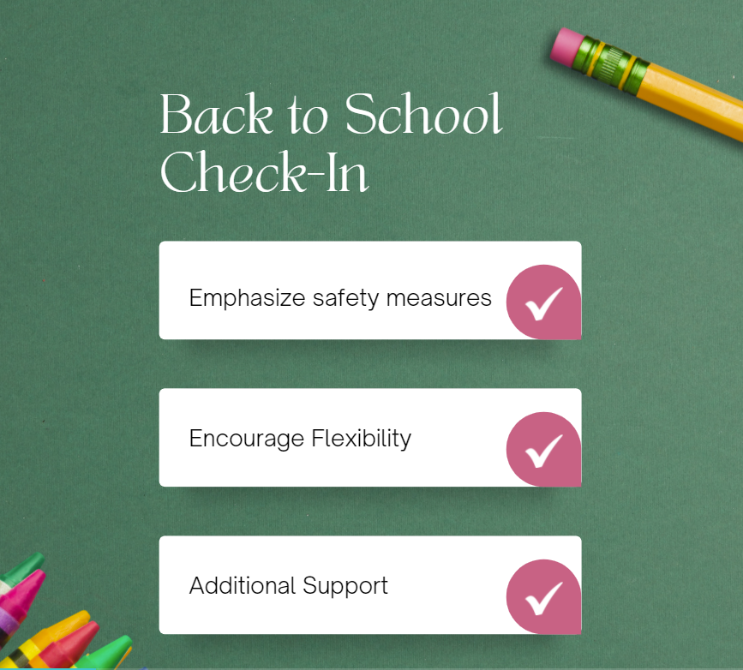
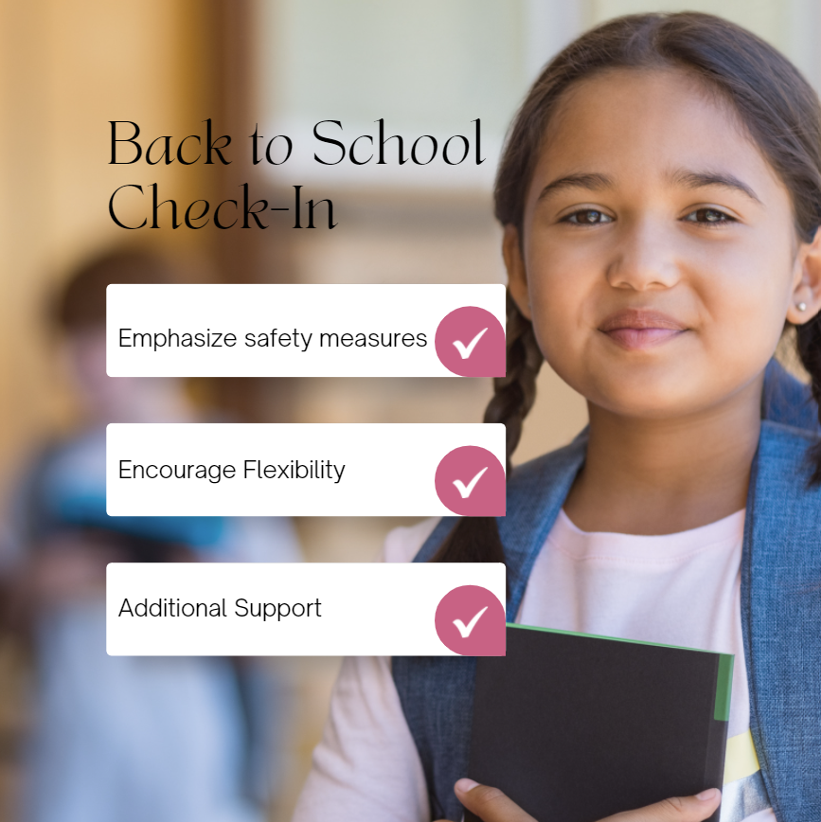
Going back to school during COVID can bring up excitement and anxiety. How can we reassure children that it’s safe AND encourage them to be careful? Here are some pointers.
We can express confidence that the schools have done months of planning to minimize risk and keep everyone.
Let your child know that the whole family is going to have to be flexible, it’s helpful for kids to know that you’re prepared for changes that may occur.
Kids who have trouble separating often just need time, and support from parents and teachers, to adjust. There’s always more support when you need it, you can reach out to your local County [insert information here]…”

Slide 14
Post 5

Slide 15

“With the community around us reopening, some anxious feelings may be popping up with your children. Work with them identify their support system and who they can go to in different situations. This could be yourself as their caregiver, a teacher or trusted adult on school campus, a coach, their friends, or possibly a local county or community based organization resource. You can learn more about support that is offered in your community here: [insert website]”

