Slide 1
Tips for Presenters
This slide is intended to help prepare you as the presenter - please remove this slide before sharing/presenting.
Here are a few things to consider before presenting:
This presentation is intended to be an introduction to workplace suicide prevention. It is not intended to train individuals in counseling, or any therapeutic modalities. Instead, it is intended to help raise awareness about the basic principles in suicide prevention.
Talking points have been added to each slide to provide you some guidance in your presentation. You are encouraged to “make the language your own” in-line with safe and effective messaging principles.
  We encourage presenters to review the recorded webinar “Principles for Effective Messaging for Suicide Prevention” prior to presenting: https://attendee.gotowebinar.com/recording/6994673372009747201
Throughout the presentation certain general resources are listed that are available through Know the Signs and other organizations. If you need help locating a specific resource, or resources for a specific population, please contact us at info@suicideispreventable.org.
K n o w t h e S i g n s >> F i n d t h e W o r d s >> R e a c h O u t >> www.SuicideIsPreventable.org

Slide 2


Working Together to Prevent Suicide
Presenter Info
K n o w t h e S i g n s >> F i n d t h e W o r d s >> R e a c h O u t
Notes:
Insert presenter contact information in text box prior to presentation; introduce yourself.
The ‘Know the Signs” Social Marketing Campaign for Suicide Prevention is part of statewide efforts to prevent suicide, reduce stigma and discrimination related to mental illness, and to promote the mental health and wellness of all people in California.
These initiatives are funded by counties through the Mental Health Services Act (Prop 63) and administered by the California Mental Health Services Authority (CalMHSA), an organization of county governments working to improve mental health outcomes for individuals, families, and communities.

Slide 3
Today’s Agenda
Why suicide prevention in the workplace?
Occupational risk and protective factors
Strategies to integrate suicide prevention in the workplace
Resources
Q&A

Slide 4
Words Matter
Use | Don’t Use
“died by Suicide” or “took their own life” | “committed suicide” Note: Use of the word commit can imply crime/sin
“attempted suicide” | “successful” or “unsuccessful” Note: There is no success, or lack of success, when dealing with suicide
Source: https://www.ncbi.nlm.nih.gov/pmc/articles/PMC6563960/
K n o w t h e S i g n s >> F i n d t h e W o r d s >> R e a c h O u t >> www.SuicideIsPreventable.org
Notes:
Before we get started, I would like to clarify some of the recommended terminology around suicide prevention.
When it comes to suicide prevention, the terms, phrases and words we use can have a significant impact on the way messages are received. Messages can either encourage someone to seek help and reach out, or they can push people further from the support they need. The suicide prevention community is trying to clarify the ways we all refer to actions related to suicide to better support help-seeking behavior among those that who are at risk.
The most common phrase we use when someone has died by suicide is “committed suicide”. It is recommended to avoid this term because it is ,most often associated with criminal actions. Framing suicide this way can bring about feelings of shame, guilt or stigma that can be hurtful to loss survivors or inadvertently reinforce a negative bias preventing people from reaching out for help.
You may have heard people refer to a “successful” or an “unsuccessful” suicide attempt. But there is no success or lack thereof when talking about suicide.
These actions should be referred to clearly as a death by suicide, or an attempted suicide. Using this phrasing helps to remove the negative bias of shame or stigma.
One recent study explored this terminology and found that among respondents, “took their own life”, “died by suicide” and “attempted suicide” received the highest consistent marks for acceptability.
Speaker’s Note: Option to share this reference if asked: Language use and suicide: An online cross-sectional survey https://www.ncbi.nlm.nih.gov/pmc/articles/PMC6563960/

Slide 5
Why suicide prevention in the workplace?
Approximately 70% of suicides are among working age adults
  In the last 10 years the rate of suicide has increased most rapidly among adults ages 18-64.
Most adults spend a significant portion of their lives at work.
For many adults, time spent at work is balanced, often precariously, against the need to care for children and aging parents.
K n o w t h e S i g n s >> F i n d t h e W o r d s >> R e a c h O u t >> www.SuicideIsPreventable.org
Notes:
For a long time suicide rates increased with age, with older adults having the highest rates.
70% of suicide deaths are among working age adults
In the last 10 years the rate of suicide among working age adults has been increasing rapidly, more than any other group.
Adults in this age group don’t gather in schools or other settings where they are a captive audience – but most do go to work, whether at a large company or a small mom and pop.
Many are balancing significant family and financial obligations with the many hours each day spent at work, or commuting to and from work.

Slide 6
Good business and the right thing to do
The workplace is can offer a sense of purpose and community, both important protective factors against suicide.
The impact of a suicide on other employees can be emotionally devastating
For a business, the financial costs– direct and indirect – can also be devastating
K n o w t h e S i g n s >> F i n d t h e W o r d s >> R e a c h O u t >> www.SuicideIsPreventable.org
Notes:
Suicide prevention is also good business: As managers and leaders, we want to do the right thing for our business and also for our employees
Employees are the largest and most important investment in any business.
The workplace can foster protective factors against suicide, including a sense of a sense of satisfaction and purpose as well as a sense of belonging and community for employees that feel supported and part of a team
The affects of a suicide on employees can be emotionally devastating, and costly.…

Slide 7
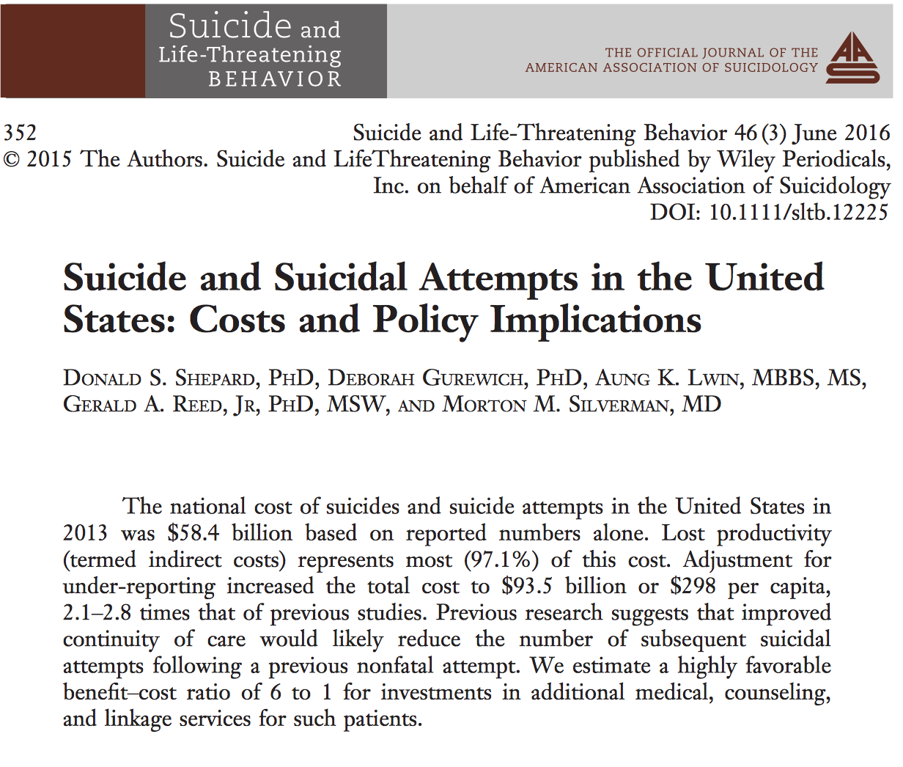
The financial impact
Prevention is a smart, and cost-effective investment
Estimated annual costs of suicide deaths and attempts: $93.5 billion
Cost of one suicide: $1,329,553
  97% indirect (lost productivity), with the remainder in medical costs
For every $1 spent on interventions and linkages for care, $2.50 is saved in the cost of suicides
K n o w t h e S i g n s >> F i n d t h e W o r d s >> R e a c h O u t >> www.SuicideIsPreventable.org
Notes:
Suicide also has economic costs, including medical costs for individuals and families, lost income for families, and lost productivity for employers.
The costs of suicidal behaviors—and the savings that can result from preventing these behaviors—can help convince business leaders that suicide prevention is an investment that will save dollars as well as lives.
For example, a recent study revealed the following:
The average cost of one suicide was $1,329,553.
More than 97 percent of this cost was due to lost productivity. The remaining 3 percent were costs associated with medical treatment.
The total cost of suicides and suicide attempts, was $93.5 billion. This estimate accounts for the total known number of suicide deaths and attempts as well as accounting for likely under-reporting of suicidal behavior based on previous studies
Every $1.00 spent on prevention and early intervention saved $2.50 in the cost of suicides.

Slide 8

Where will your agency start?
Notes:
The next section of the presentation will share a comprehensive blueprint for how your agency can get started.

Slide 9
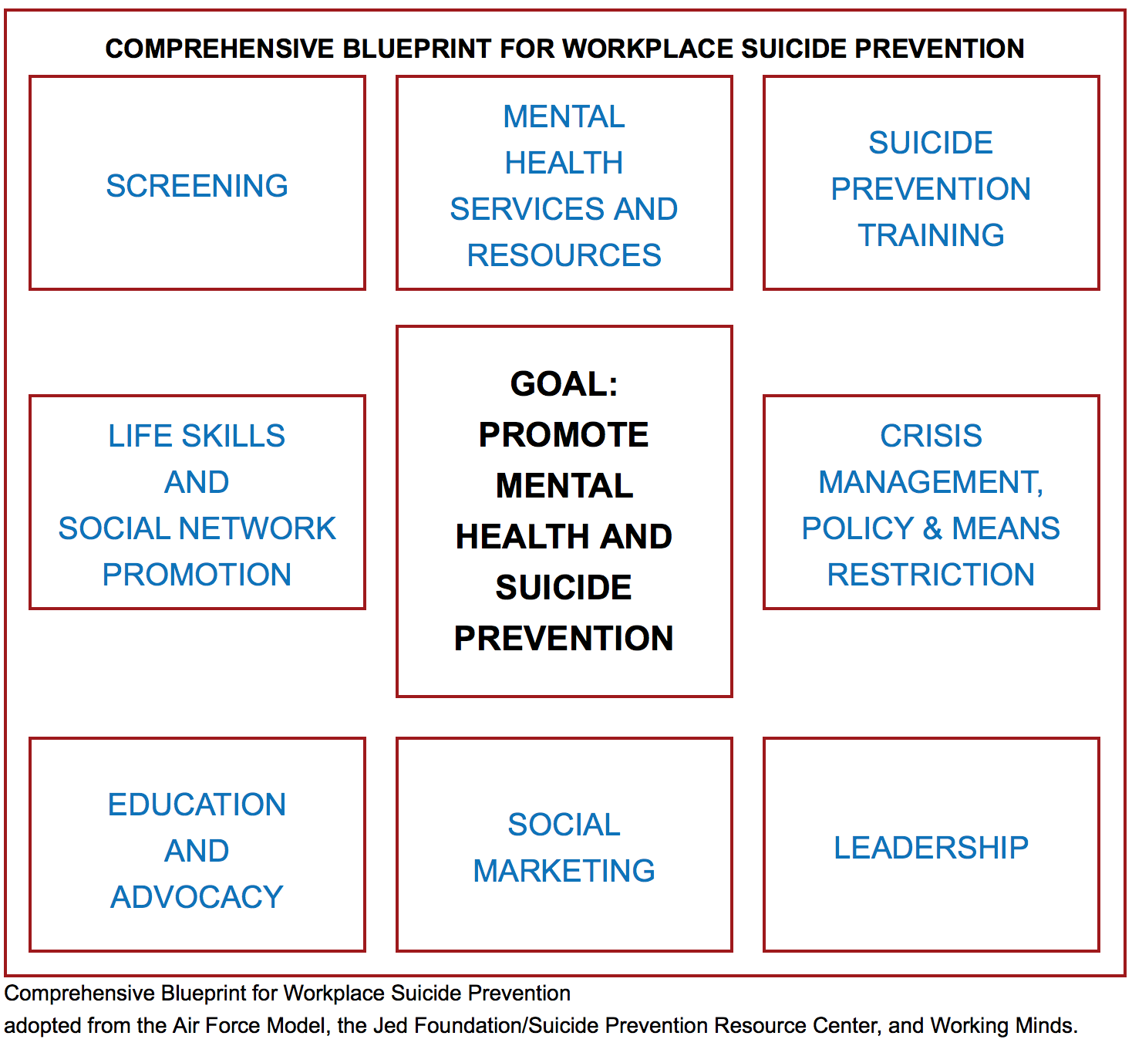
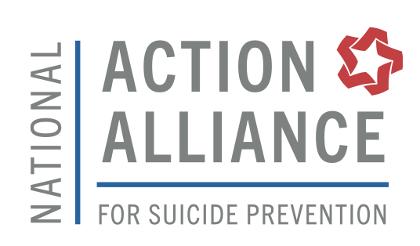
K n o w t h e S i g n s >> F i n d t h e W o r d s >> R e a c h O u t >> www.SuicideIsPreventable.org
Notes:
The Comprehensive Blueprint for Workplace Suicide Prevention is part of a national public-private partnership, the Action Alliance for Suicide Prevention with Working Minds, the Suicide Prevention Resource Center, and the Jed Foundation.
The Blueprint was adapted from the Air Force Suicide Prevention Program, a comprehensive program that demonstrated reductions in suicide, as well as other negative outcomes such as interpersonal violence and substance abuse.
It outlines 8 areas of action that workplaces can take to promote suicide prevention. They include actions that can prevent problems from occurring as well as ways to promote healing and support after a crisis.
We will delve into five strategies from this blueprint that you can do to take action at your workplace.
https://theactionalliance.org/resource/comprehensive-blueprint-workplace-suicide-prevention

Slide 10
What is a comprehensive approach?
UPSTREAM | MIDSTREAM | DOWNSTREAM
Shift workplace cultural perspective Develop life skills Improve mental health and addiction knowledge Promote social networks | Identify people at risk Promote help-seeking Increase access to quality care | Promote worker use of mental health services Restrict access to potentially lethal means Provide support after suicide
K n o w t h e S i g n s >> F i n d t h e W o r d s >> R e a c h O u t >> www.SuicideIsPreventable.org
Notes:
A comprehensive approach is a based on the public health model for addressing major health concerns
It includes strategies that are upstream, midstream, and downstream
From the classic public health parable:
Imagine you’re standing on the edge of a river. Suddenly a flailing child floats by. Without thinking, you dive in, grab the child, and swim to shore. Before you can recover another child comes floating by. You dive in and rescue her as well.
Then another child drifts into sight. . . and another. . . and another.
You call for help, and people take turns fishing out child after child. Hopefully before too long some wise person will ask: What is causing these children to fall into the river? The wise person heads upstream to find out.
Strategies are needed upstream, to try and prevent the cause of the problem; midstream to intervene early to help those who are about to fall in, or who have fallen in as quickly as possible; and downstream to manage the crisis, pull out those who have been flailing for a while and help those who have just been pulled out to recover.
This presentation will focus on midstream and downstream approaches, but stay tuned as Each Mind Matters works with our partners in the coming year to support implementation of more upstream approaches.

Slide 11
A safe and supportive workplace
Screening opportunities are in place
Employees know what behavioral health resources are available and how to access them
Employees are educated about the warning signs of suicide and mental health crises and feel confident to reach out
Managers and supervisors, at minimum, are trained in suicide prevention
Plans are in place for what to do in a crisis, and to offer support and healing after suicide
K n o w t h e S i g n s >> F i n d t h e W o r d s >> R e a c h O u t >> www.SuicideIsPreventable.org
Notes:
These general strategies will help get your workplace started. They will require planning and buy-in from leadership down to individual staff.
This investment will pay off in the long run by promoting a workplace that cares about the wellness of staff and encourages employees to reach out when they are concerned about others, or for themselves.
Let’s review each of these in more detail.

Slide 12
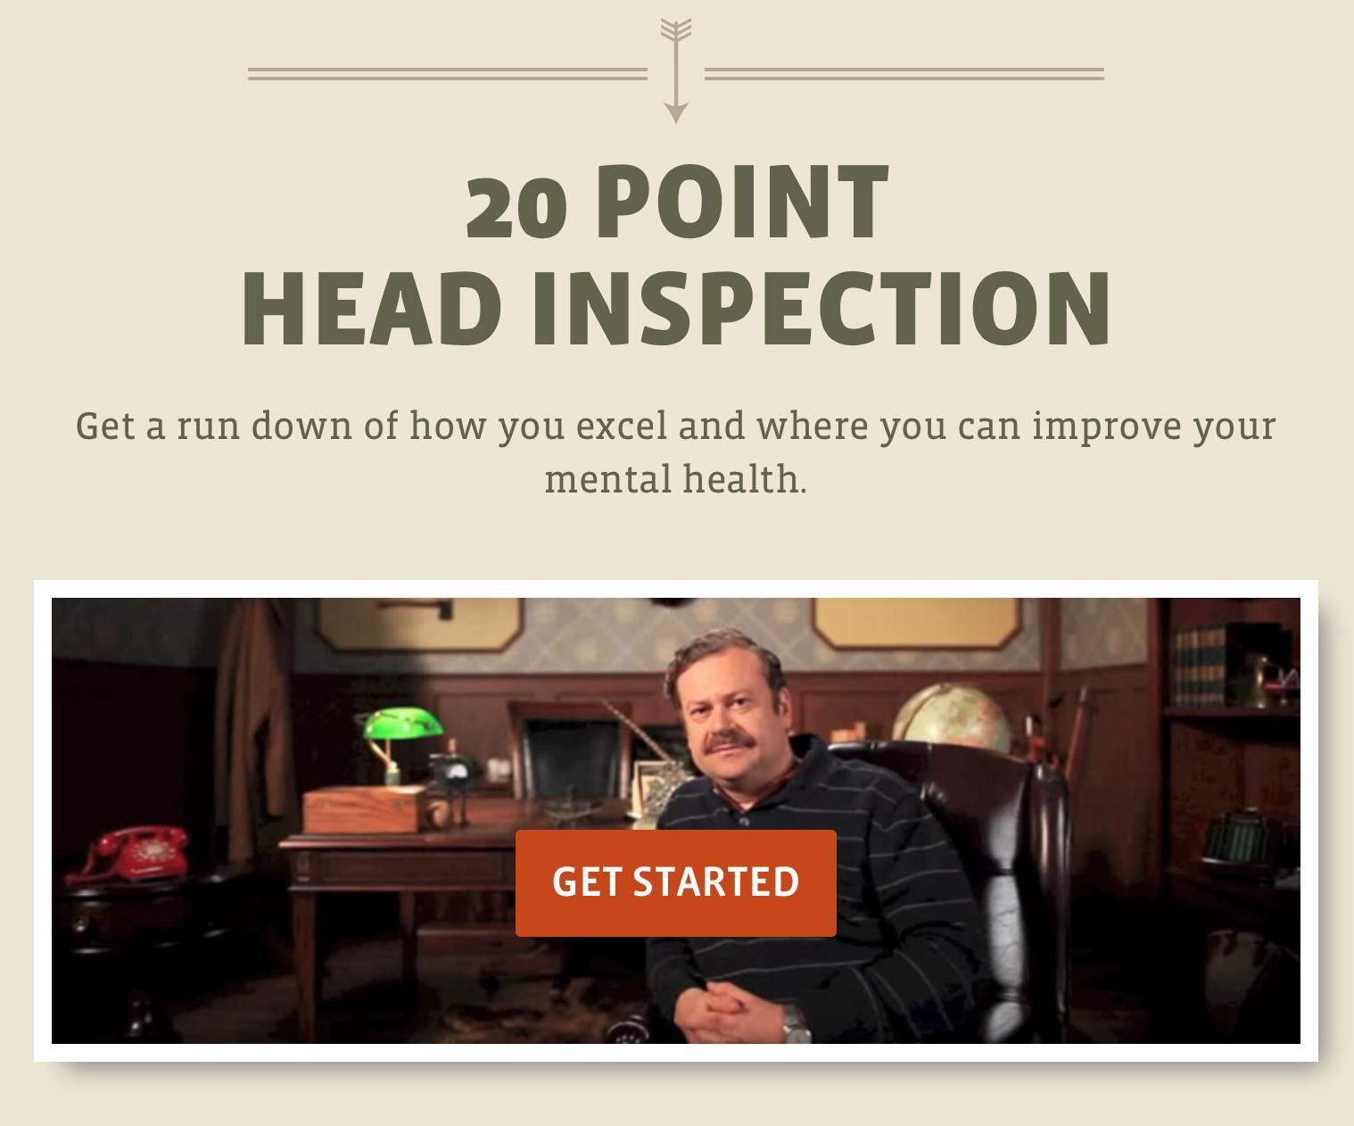
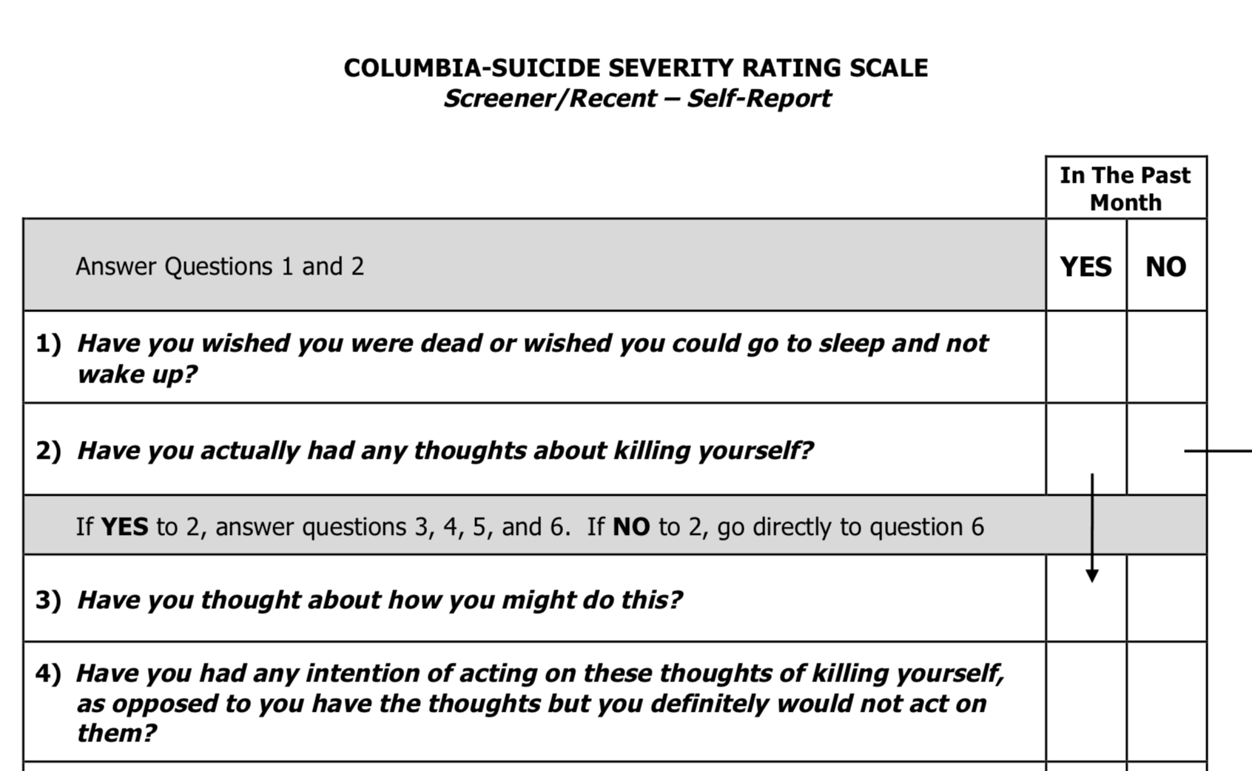
Encourage screening
Screening helps to identify problems early and can facilitate access to quality care and supports.
K n o w t h e S i g n s >> F i n d t h e W o r d s >> R e a c h O u t >> www.SuicideIsPreventable.org
Notes:
Identify people at risk and emerging problems before they become a crisis.
Screening is one way to do this –just as we screen for heart problems by checking blood pressure and cholesterol, screening for depression, anxiety, suicidal ideation, and substance mis-use can help identify people at risk. Self assessments can help employees recognize when their own behaviors might signal a potential problem.
Examples include the Columbia Suicide Severity Rating Scale self screening tool, or the Man Therapy web site which offers a self screening tool geared toward men.
Consult with local mental health and health care providers, as well as your EAP if available, to learn more about screening tools.

Slide 13
Considerations for screening
Be clear that the purpose of screening is to support employees to assess their own risk and support their wellness.
Screening tools can also be administered by trained counselors through EAPs or other programs or at wellness events.
Provide assurances that the results of screening tools are confidential and will not be shared with supervisors or managers.
Ensure that screening opportunities are followed by information about resources available to help.
K n o w t h e S i g n s >> F i n d t h e W o r d s >> R e a c h O u t >> www.SuicideIsPreventable.org
Notes:
When sharing screening tools, assure employees that the purpose is to support their overall wellness, not as part of a performance review or other job evaluation.
Administer and share screening tools in venues and formats that ensure confidentiality and trust in the process. Examples can be self screening processes, counseling programs or EAPs, or at wellness events where employees can complete the screening privately.
Make sure that screening opportunities are closely followed by information about resources that are available to help with the level of risk identified, from crisis services such as the Lifeline or a local crisis center, to counseling and behavioral health services offered trough the EAP, employee insurance plans, or in the community.

Slide 14
Promote behavioral health resources
  Create an inventory of behavioral health and other resources to support the whole employee.
  Make sure employees know what behavioral health benefits are available to them, and encourage their use
  Ensure EAP staff are knowledgeable of behavioral health resources and how to connect employees to help; advocate for suicide prevention and risk assessment training
  Display educational materials, such as Know the Signs brochures and posters
K n o w t h e S i g n s >> F i n d t h e W o r d s >> R e a c h O u t >> www.SuicideIsPreventable.org
Notes:
Compile an inventory of behavioral health and other resources that are available to support employees.
Include crisis services such as the Lifeline or a local crisis center and behavioral health counseling services in the community, as well as EAP services.
Consider including resources that offer support for working through life challenges such as debt, family or legal issues.
Post the list in common areas, on the intranet, and make sure they are included with new employee information packets.
Make sure employees understand the behavioral health benefits that are available to them through their employee insurance plans and the EAP. If these are not available, provide information about low or no cost counseling services in the community.
Ensure your EAP staff is knowledgeable about behavioral health resources and how to connect employeesto the help they need. Advocate they receive suicide prevention and suicide risk assessment training if they do not have it.
Display Know the Signs and other materials in break rooms and around the workplace. Include a link to Know the Signs on the intranet.

Slide 15
Offer suicide prevention training
At minimum, managers, supervisors, and HR staff receive suicide prevention training
Ensure that they know how to have difficult conversations and feel confident to connect staff with resources
Identify the training model that is right for your workplace
  For more information about training visit www.LivingWorks.net, www.QPRinstitute.com or talk to your local behavioral health agency or crisis center.
K n o w t h e S i g n s >> F i n d t h e W o r d s >> R e a c h O u t >> www.SuicideIsPreventable.org
Notes:
Suicide prevention training increases knowledge of the warning signs of suicide and how to have difficult conversations in ways that show empathy and proactively support people in distress.
More information about training can be found at these web sites.
Training models vary from 2 hours to 2 days and may require travel or be done on line.
Training is a financial and time investment but this investment will pay off in the long run in a workplace that is more informed and ready to offer help to those in distress.

Slide 16
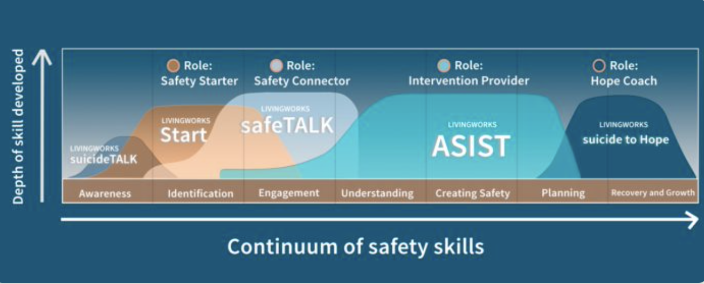
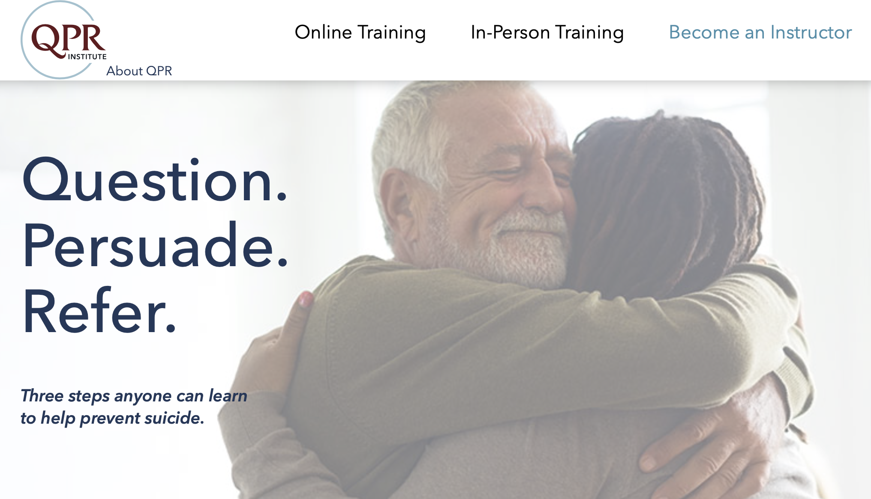

Suicide Prevention Training
https://www.livingworks.net
https://qprinstitute.com
K n o w t h e S i g n s >> F i n d t h e W o r d s >> R e a c h O u t >> www.SuicideIsPreventable.org
Notes:
Suicide prevention training increases knowledge of the warning signs of suicide and how to have difficult conversations in ways that show empathy and proactively support people in distress.
More information about training can be found at these web sites. There are a wide range of trainings available, but these are two great places to start.
Training models vary from 2 hours to 2 days and may require travel or be done on line.
Training is a financial and time investment but this investment will pay off in the long run in a workplace that is more informed and ready to offer help to those in distress.

Slide 17
Provide educational opportunities
Increase knowledge of behavioral health and wellness and suicide prevention to all staff
Host presentations, brown bag lunches, and wellness events
Post articles in newsletters, on the intranet, or using social media channels that share useful information about help and recovery.
Learn and share about ways to talk about mental health and suicide that reduce stigma
K n o w t h e S i g n s >> F i n d t h e W o r d s >> R e a c h O u t >> www.SuicideIsPreventable.org
Notes:
Develop an ongoing calendar of educational events and messaging opportunities that share useful information about behavioral health and wellness and suicide prevention.
Topics can include knowing the signs of suicide and how to help, tips for coping with stress and managing conflict, and information about healthy lifestyles and creating balance.
Venues can include wellness fairs or events, brown bag lunch presentations, and sharing articles via social media, the intranet, or within newsletters.
The conversations we have day to day can have a big impact on how comfortable people are talking about mental health and suicide and can contribute to the stigma that makes many people reluctant to seek help for their challenges. Learn about ways to talk about mental health and suicide that help reduce stigma. The Each Mind Matters web site is a great place to start.

Slide 18
Develop a crisis plan
Safe, timely, and compassionate response
Review of organizational policies and needs
Detailed steps for how information will flow and what actions will be taken to support those affected
Include components that address access to lethal means and offer support after a suicide death.
Proactively offer resources and support during times of stress
K n o w t h e S i g n s >> F i n d t h e W o r d s >> R e a c h O u t >> www.SuicideIsPreventable.org
Notes:
Do you have fire drills to make sure everyone gets out safely in the event of a fire or other disaster?
Do you have policies and protocols in place to protect workers against injuries on the job?
Planning for a crisis related to mental health or suicide, like planning escape routes in the event of a fire, supports not only the person in crisis, but everyone around them who is in a position to help.
Review policies about medical leave, ensure policies don’t discriminate against behavioral health issues. Consider where accommodations can be made to support a person during a crisis, and as they reintegrate back to work after the crisis has passed.
Make the plan specific, update it regularly, and make sure managers and supervisors have it.
Plan for safety for the individual in crisis, including their access to lethal means in the workplace. Encourage them to remove guns and pills from their home – they can ask a trusted person to hold on to them until they are in a better place.
Proactively plan for offering more support and messaging during times of stress – economic down turns, layoffs and furloughs, as well as events that happen outside the workplace that may deeply impact employees

Slide 19
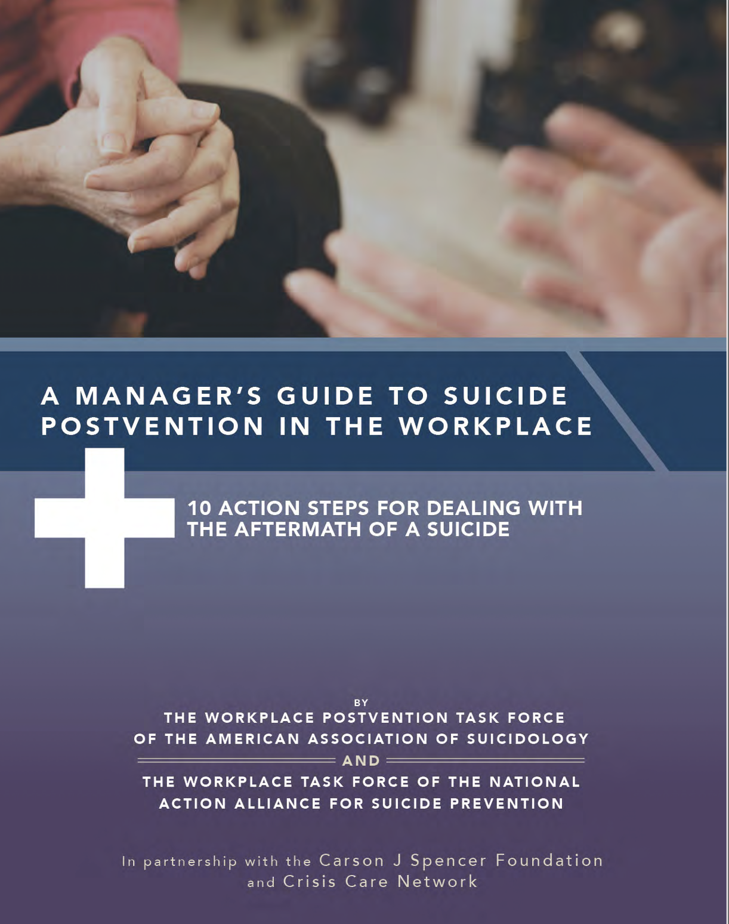
Postvention after suicide
Suicide often has a ripple effect, and can lead to significant distress on those left behind
Timely and compassionate response after suicide promotes healing and connects people with helpful resources
Postvention plans include:
  Communication about the death
  Mobilization of resources to support the bereaved
  Strategies to reduce the risk of contagion – additional suicides among those impacted by the death – and support coworkers
  Safely memorializing the deceased
K n o w t h e S i g n s >> F i n d t h e W o r d s >> R e a c h O u t >> www.SuicideIsPreventable.org
Notes:
Many of us have been impacted by the loss of someone to suicide. It may have been someone close to us, or someone we knew in passing. Even the death of someone we never knew personally, such as a celebrity, can lead to significant distress and even the risk of contagion – additional suicide deaths related to the loss. Survivors of suicide loss experience complicated grief that sets it apart from other causes of death, which may include intense feelings of guilt or shame.
How a suicide is talked about, how information is shared, and whether resources to support the bereaved are readily available, can all help alleviate distress and connect people with useful information, services, and supports.
A postvention plan supports everyone in the workplace, from managers and supervisors who must offer leadership to employees who are in distress. Having the steps laid out ahead of time reduces unnecessary stress, and potential delays in effective response, during a crisis.
Postvention plan elements include:
How information will be communicated. Developing a template email letter or memo facilitates timely and compassionate messaging about the death.
Listing of suicide support resources, including loss survivor programs, counselors with experience in suicide bereavement, faith community resources, and others that can be readily shared.
Considerations for how the deceased may be memorialized at work that avoid inadvertently glorifying the death or that treat the death differently from others.

Slide 20
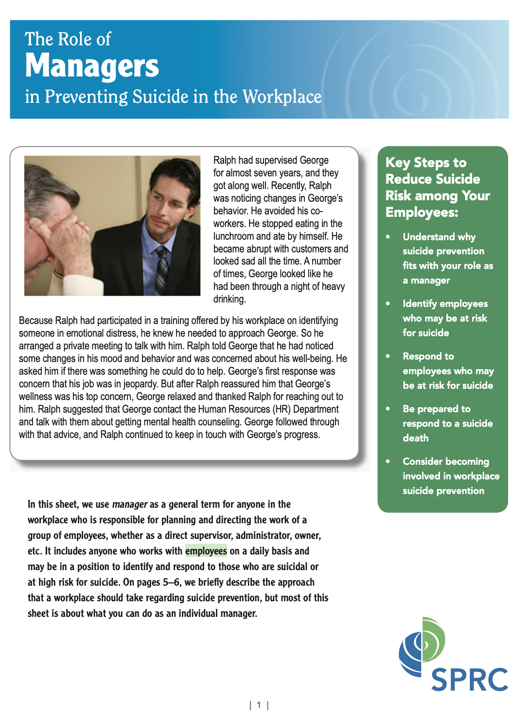
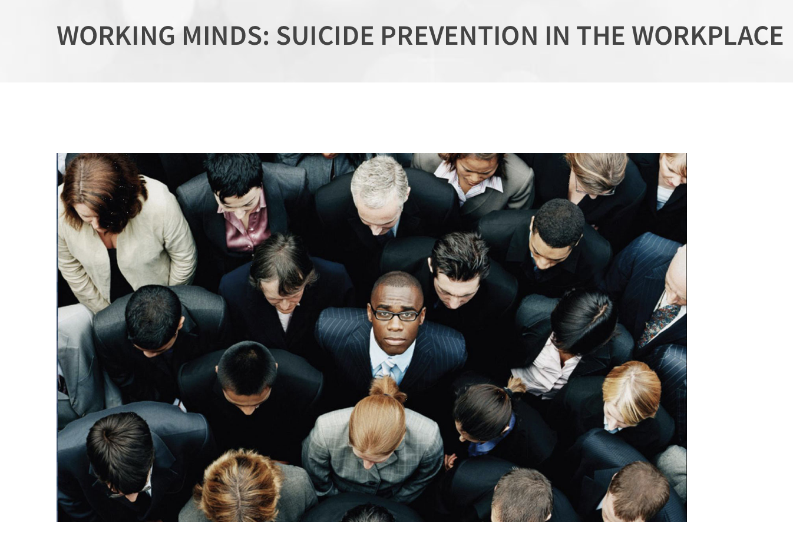

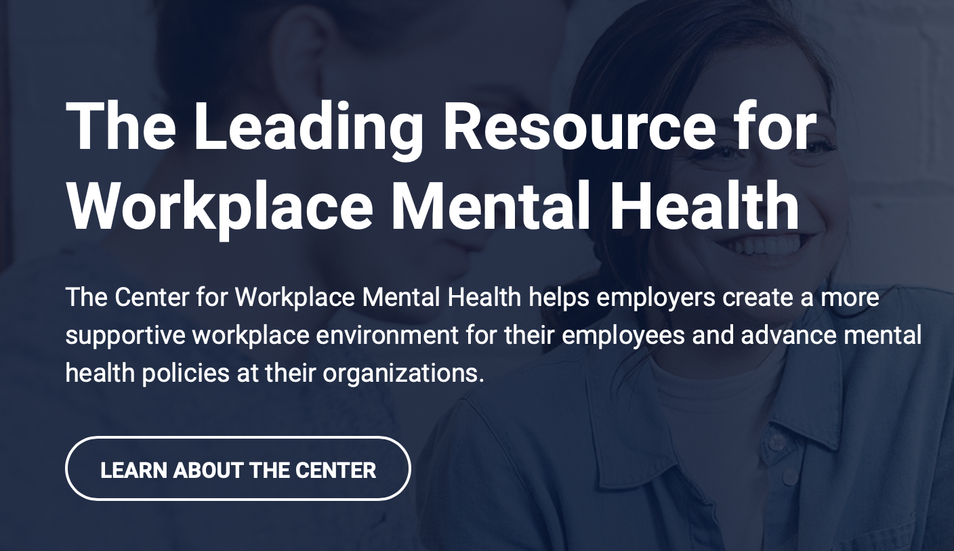
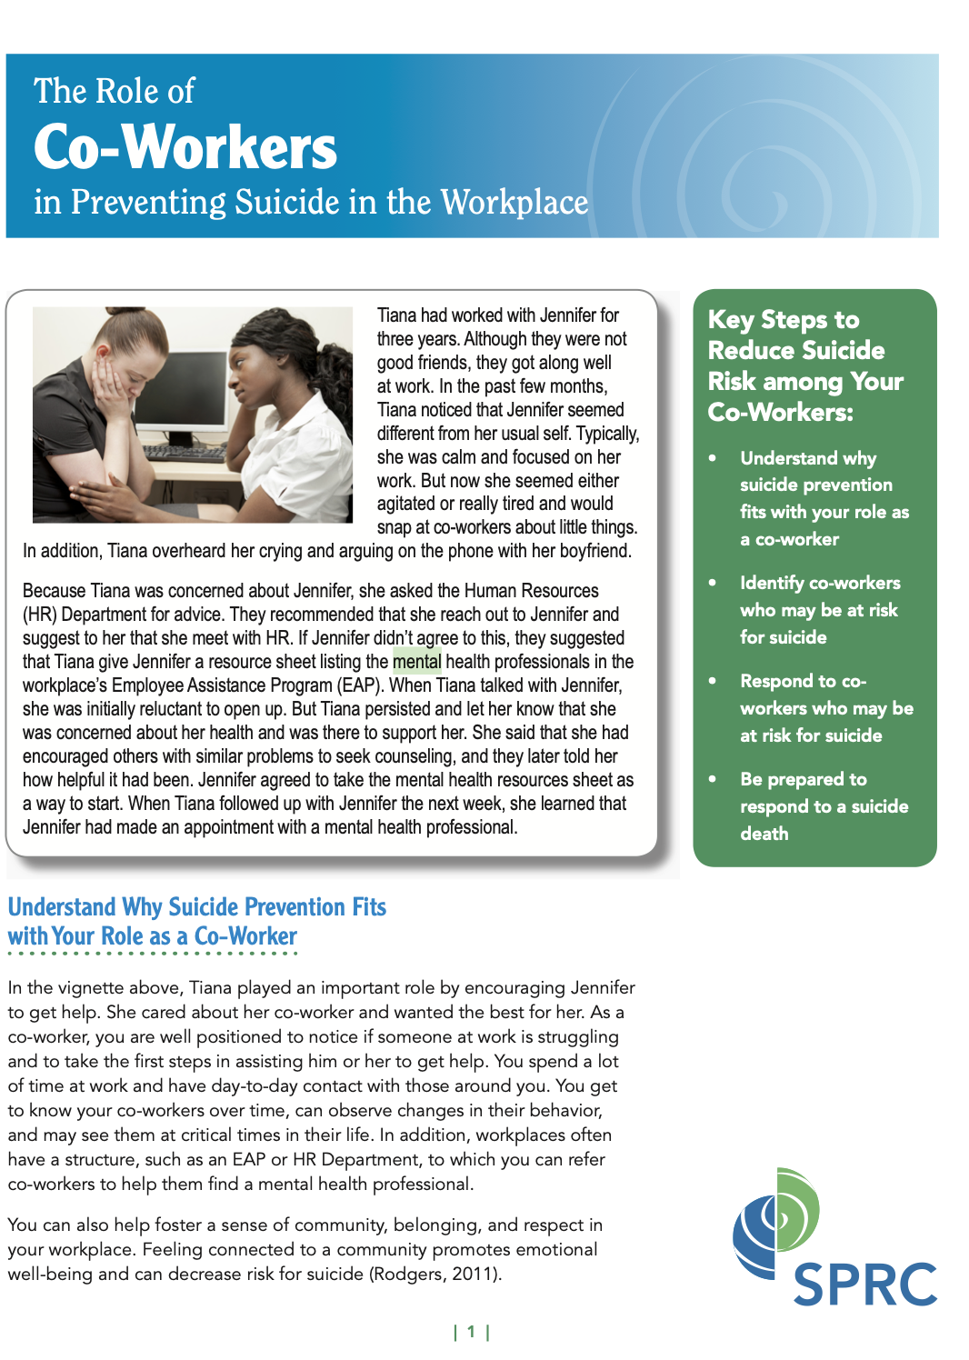
Additional Resources
K n o w t h e S i g n s >> F i n d t h e W o r d s >> R e a c h O u t >> www.SuicideIsPreventable.org
Notes:
Additional resources include the following:
Left side of the screen – from www.sprc.org
Suicide Prevention Resource Center - Workplaces - fact sheets and tools for managers and coworkers on suicide prevention and postvention.
The Role of Managers: https://www.sprc.org/resources-programs/role-managers-preventing-suicide-sprc-customized-information-series
The role of Coworkers: https://www.sprc.org/resources-programs/role-co-workers-preventing-suicide-sprc-customized-information-series
Manager’s guide to postvention in the workplace: https://www.sprc.org/resources-programs/managers-guide-suicide-postvention-workplace-10-action-steps-dealing-aftermath
Top right of slide - Mental Health America (https://www.mhanational.org/) - Workplace Mental Health Programs
Middle of Slide - Center for Workplace Mental Health (https://www.workplacementalhealth.org) - tools, resources and information to promote and support the mental health of employees and their families.

Slide 21
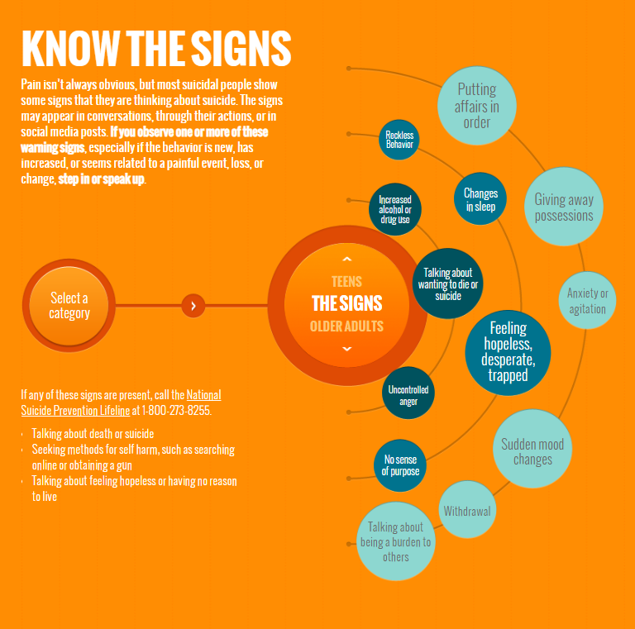
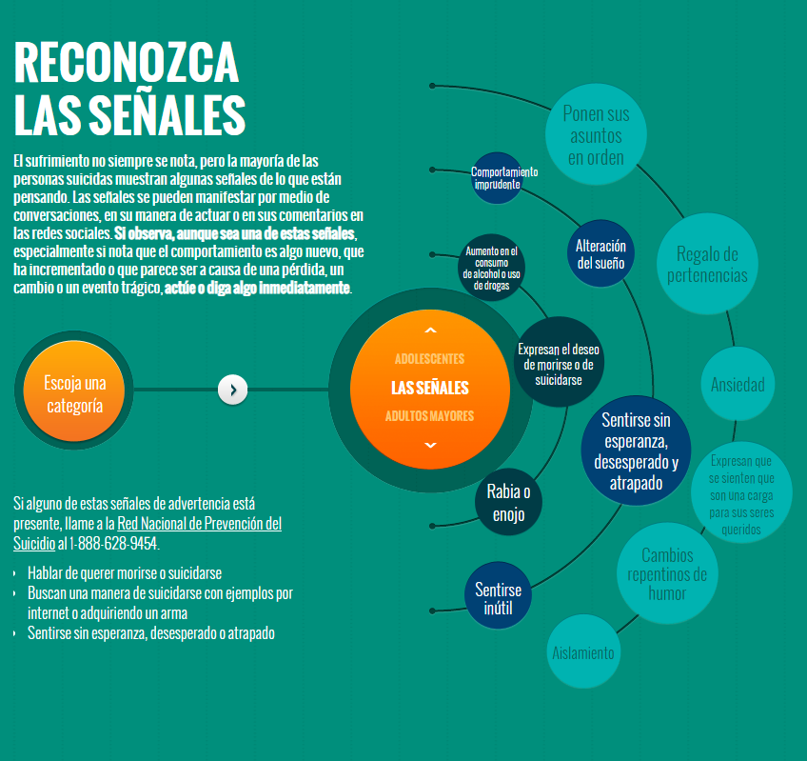
SuicideIsPreventable.org
ElSuicidioEsPrevenible.org
K n o w t h e S i g n s >> F i n d t h e W o r d s >> R e a c h O u t >> www.SuicideIsPreventable.org
Notes:
This slide shows the Know the Signs and Reconozca Las Senales web sites. Each offer a wealth of information similar to what we have talked about in this presentation, such as warning signs, how to have the conversation with someone you’re concerned about, and resources at the state and county levels.

Slide 22

Q&A
K n o w t h e S i g n s >> F i n d t h e W o r d s >> R e a c h O u t >> www.SuicideIsPreventable.org
Notes:
Speaker’s note: If there is time, pause for questions.

Slide 23
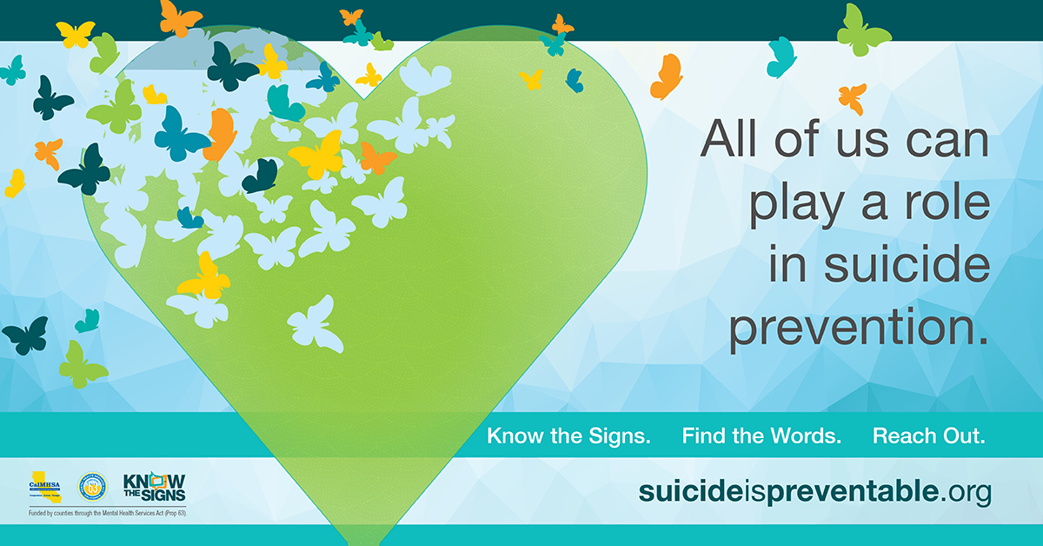
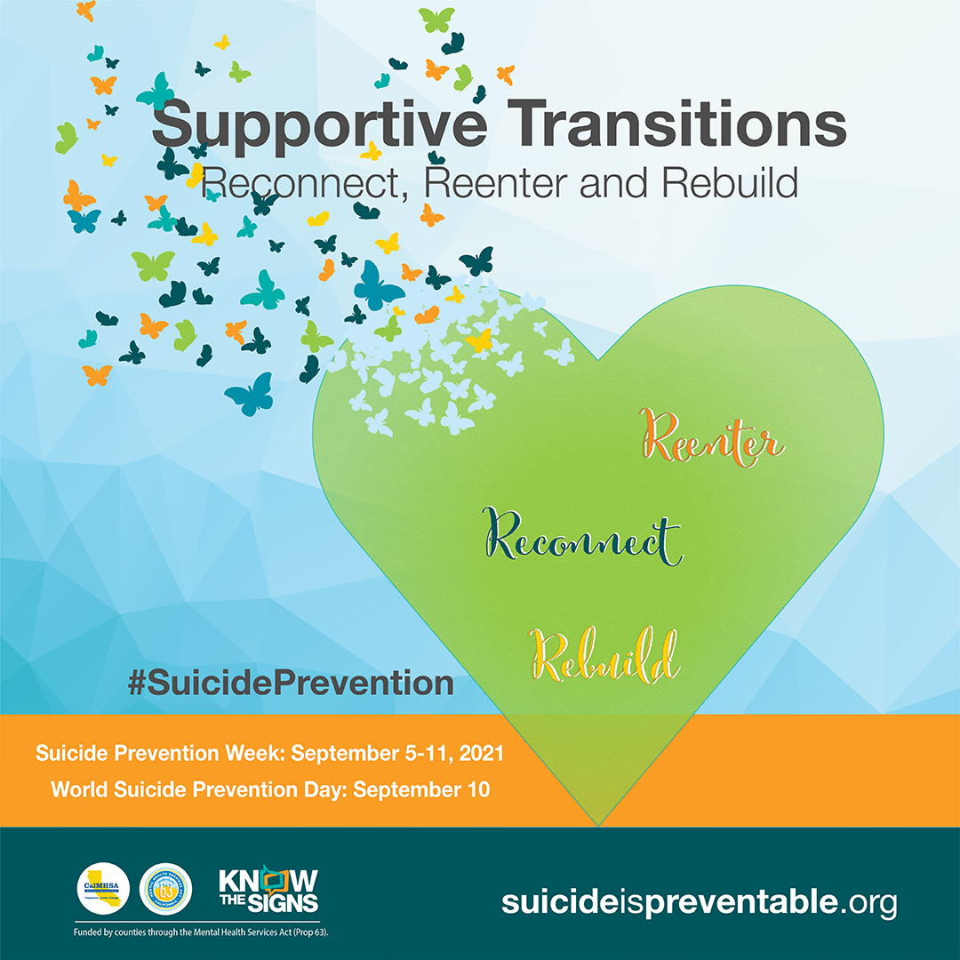
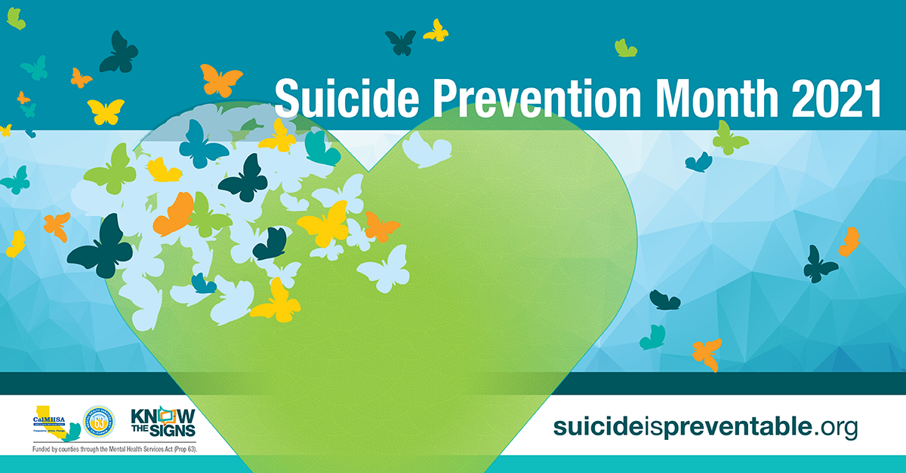
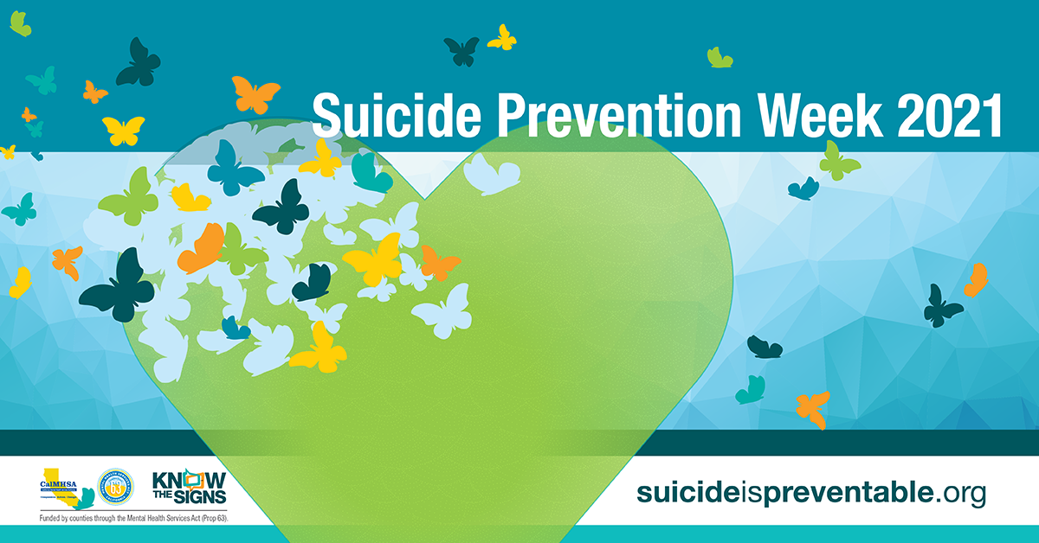
Notes:
These are some of the materials available featuring the theme: Social Media Posts, digital banners and a poster featuring suicide prevention resources.
These materials can be integrated into communications with employees, such as newsletters, emails, and intranet sites, and posted around the workplace.

Slide 24
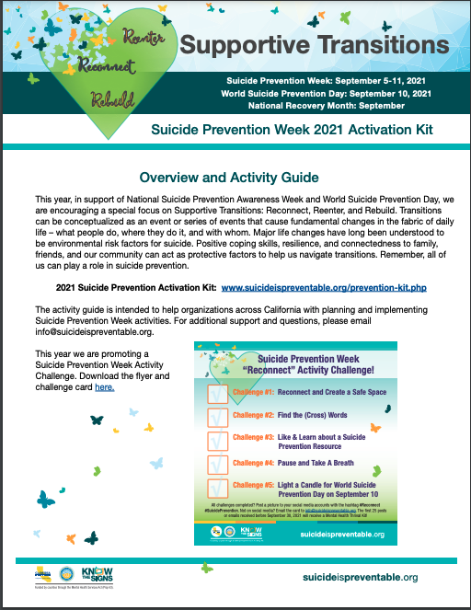
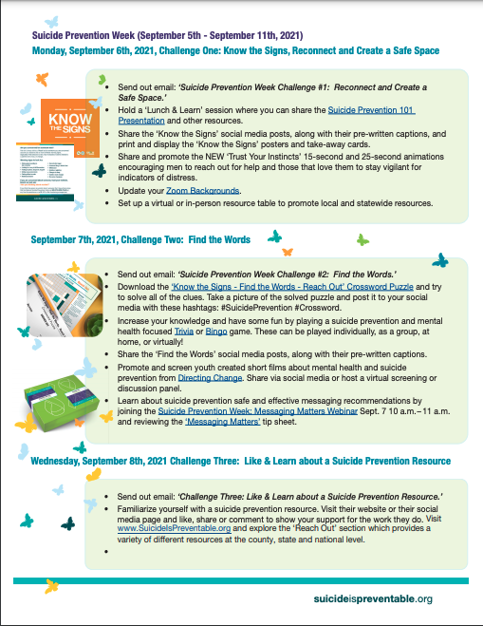
Suicide Prevention Week Activity Guide
Notes:
The Activity Guide includes ideas for how to use materials throughout Suicide Prevention Week or at any time throughout the year as part of a workplace wellness campaign.

Slide 25
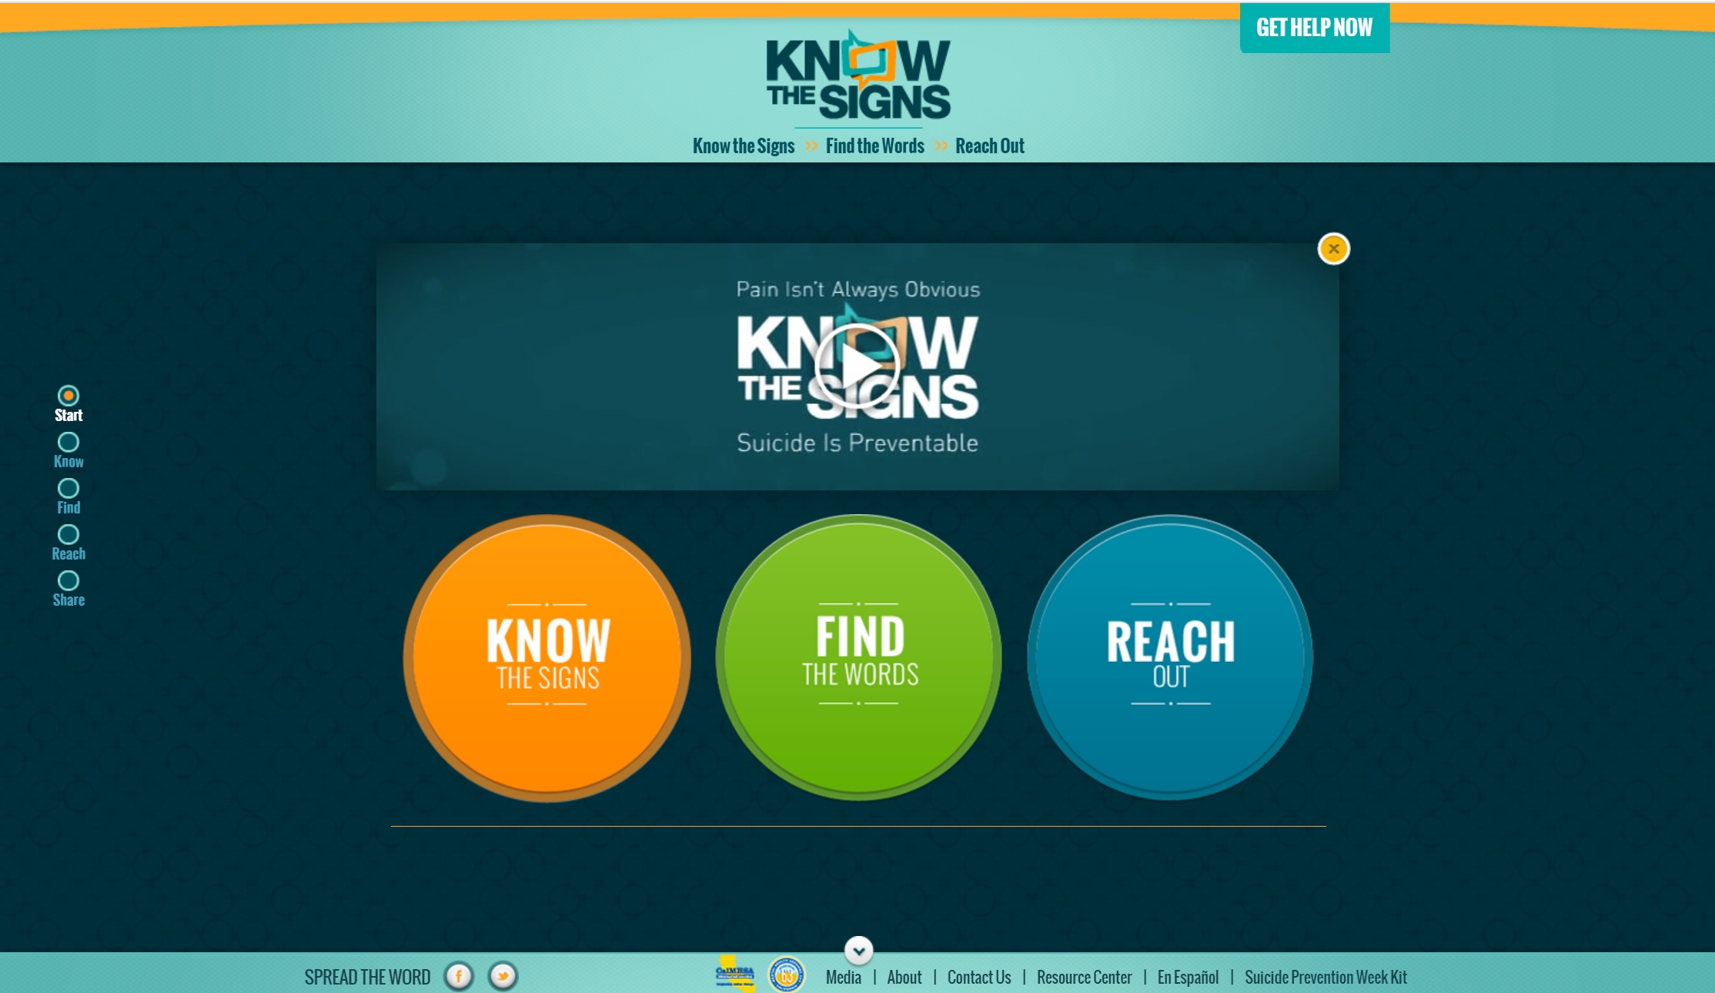
Notes:
The Know the Signs campaign web site is a great place to learn more about warning signs, finding the words to help someone you are concerned about, and reach out to local resources in your community.
The menu at the very bottom of the page links to the Suicide Prevention Week Kit and other campaign resources.

Slide 26
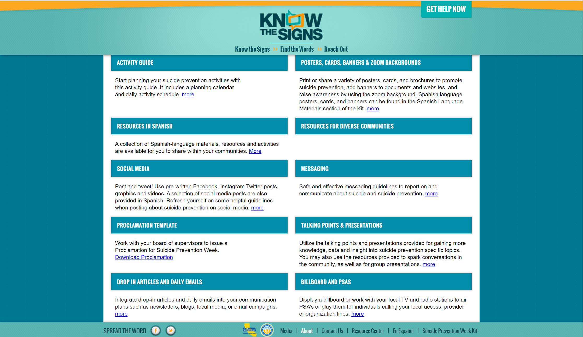
Notes:
From the home page of the Kit, educational and outreach tools and resources are available to view and download.
Many materials are bilingual in English and Spanish. There is a also a dedicated section for suicide prevention resources for diverse communities and in different languages.

Slide 27
Thank you!
Insert presenter info here
K n o w t h e S i g n s >> F i n d t h e W o r d s >> R e a c h O u t >> www.SuicideIsPreventable.org
Notes:
Provide contact information on this slide.

